Slide 1
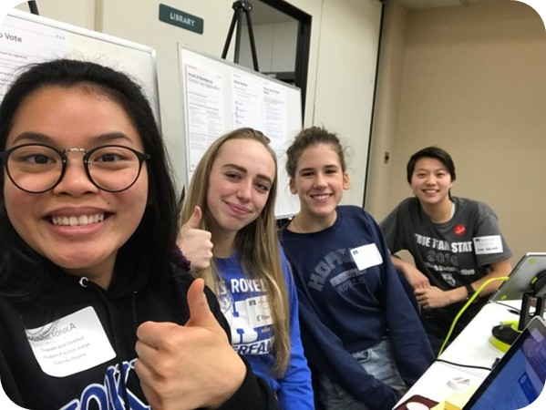
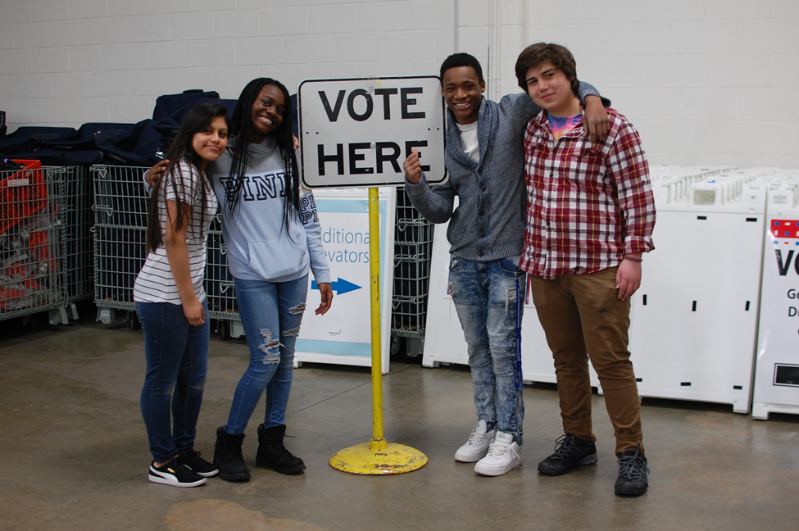
Being a Student Election Judge
Michael Wall
Voter Outreach

Slide 2
SEJ OPPORTUNITY AGENDA
Intro to what is it
Why do it
More of what it is
SEJ vs. EJ
How to apply and prepare
Questions/Discussion

Slide 3
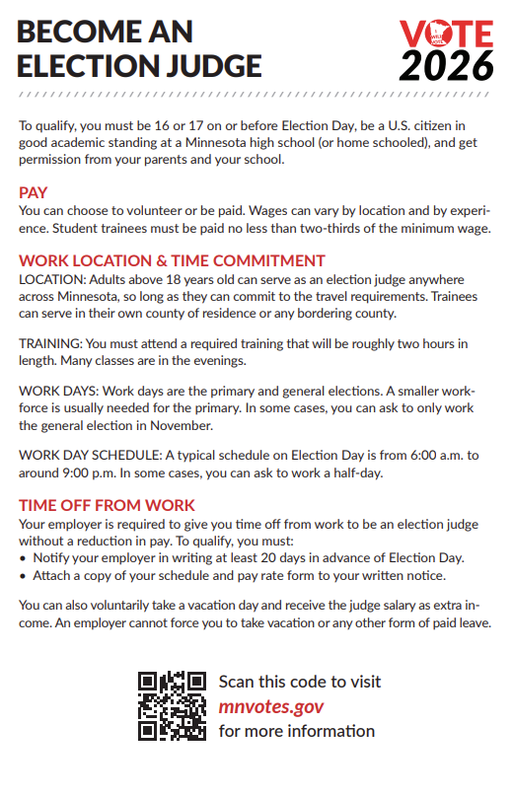
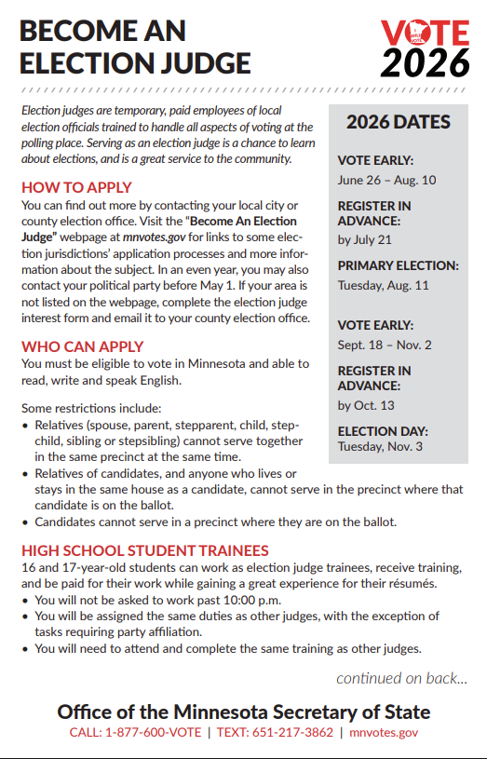
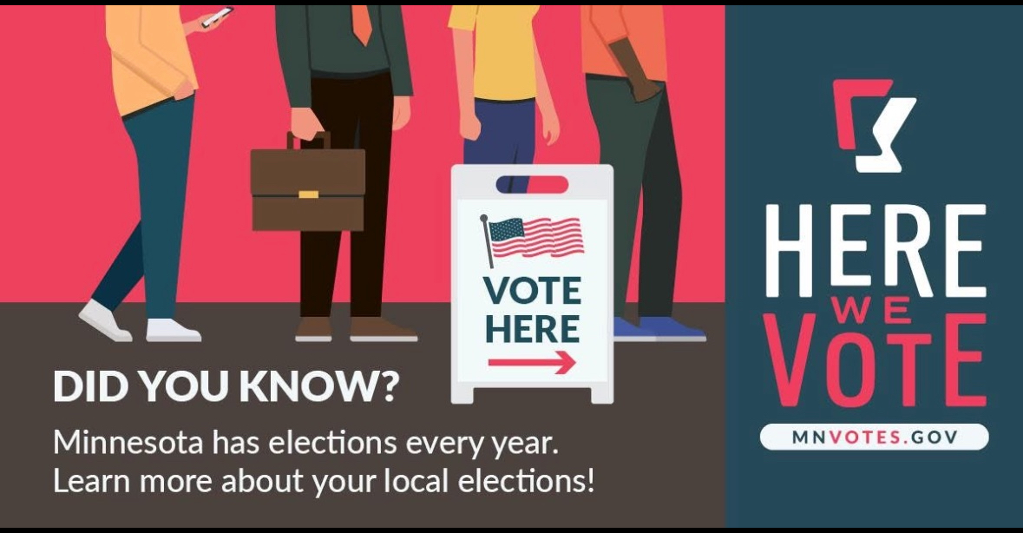
Elections are held every year. In even years 30,000+ Election Judges are needed!

Slide 4
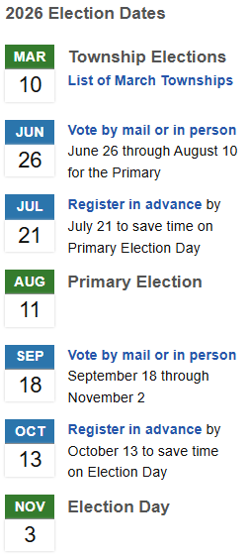
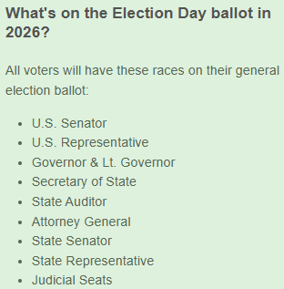
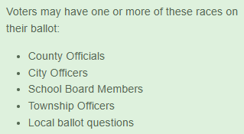
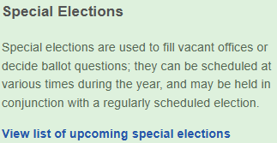
2026 Elections
BONUS INFO

Slide 5
What is an Election Judge?
Election judges are temporary, paid employees of local election officials trained to handle all aspects of voting at the polling place. Serving as an election judge is a chance to learn about elections, and is a great service to the community

Slide 6
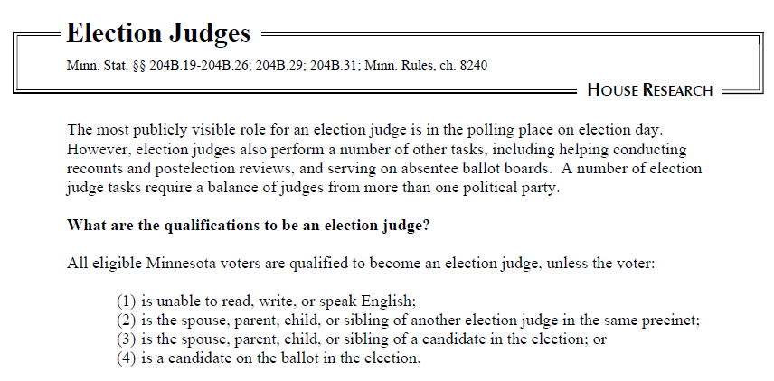
A MATTER OF LAW

Slide 7
ELIGIBILITY
MN 204B.19
Any individual who is eligible to vote in this state is qualified to be appointed as an election judge.
No if:
is unable to read, write, or speak English
is the spouse, parent, child, or sibling of another election judge in the same precinct
is the spouse, parent, child, or sibling of a candidate in the election
is a candidate on the ballot in the election.

Slide 8
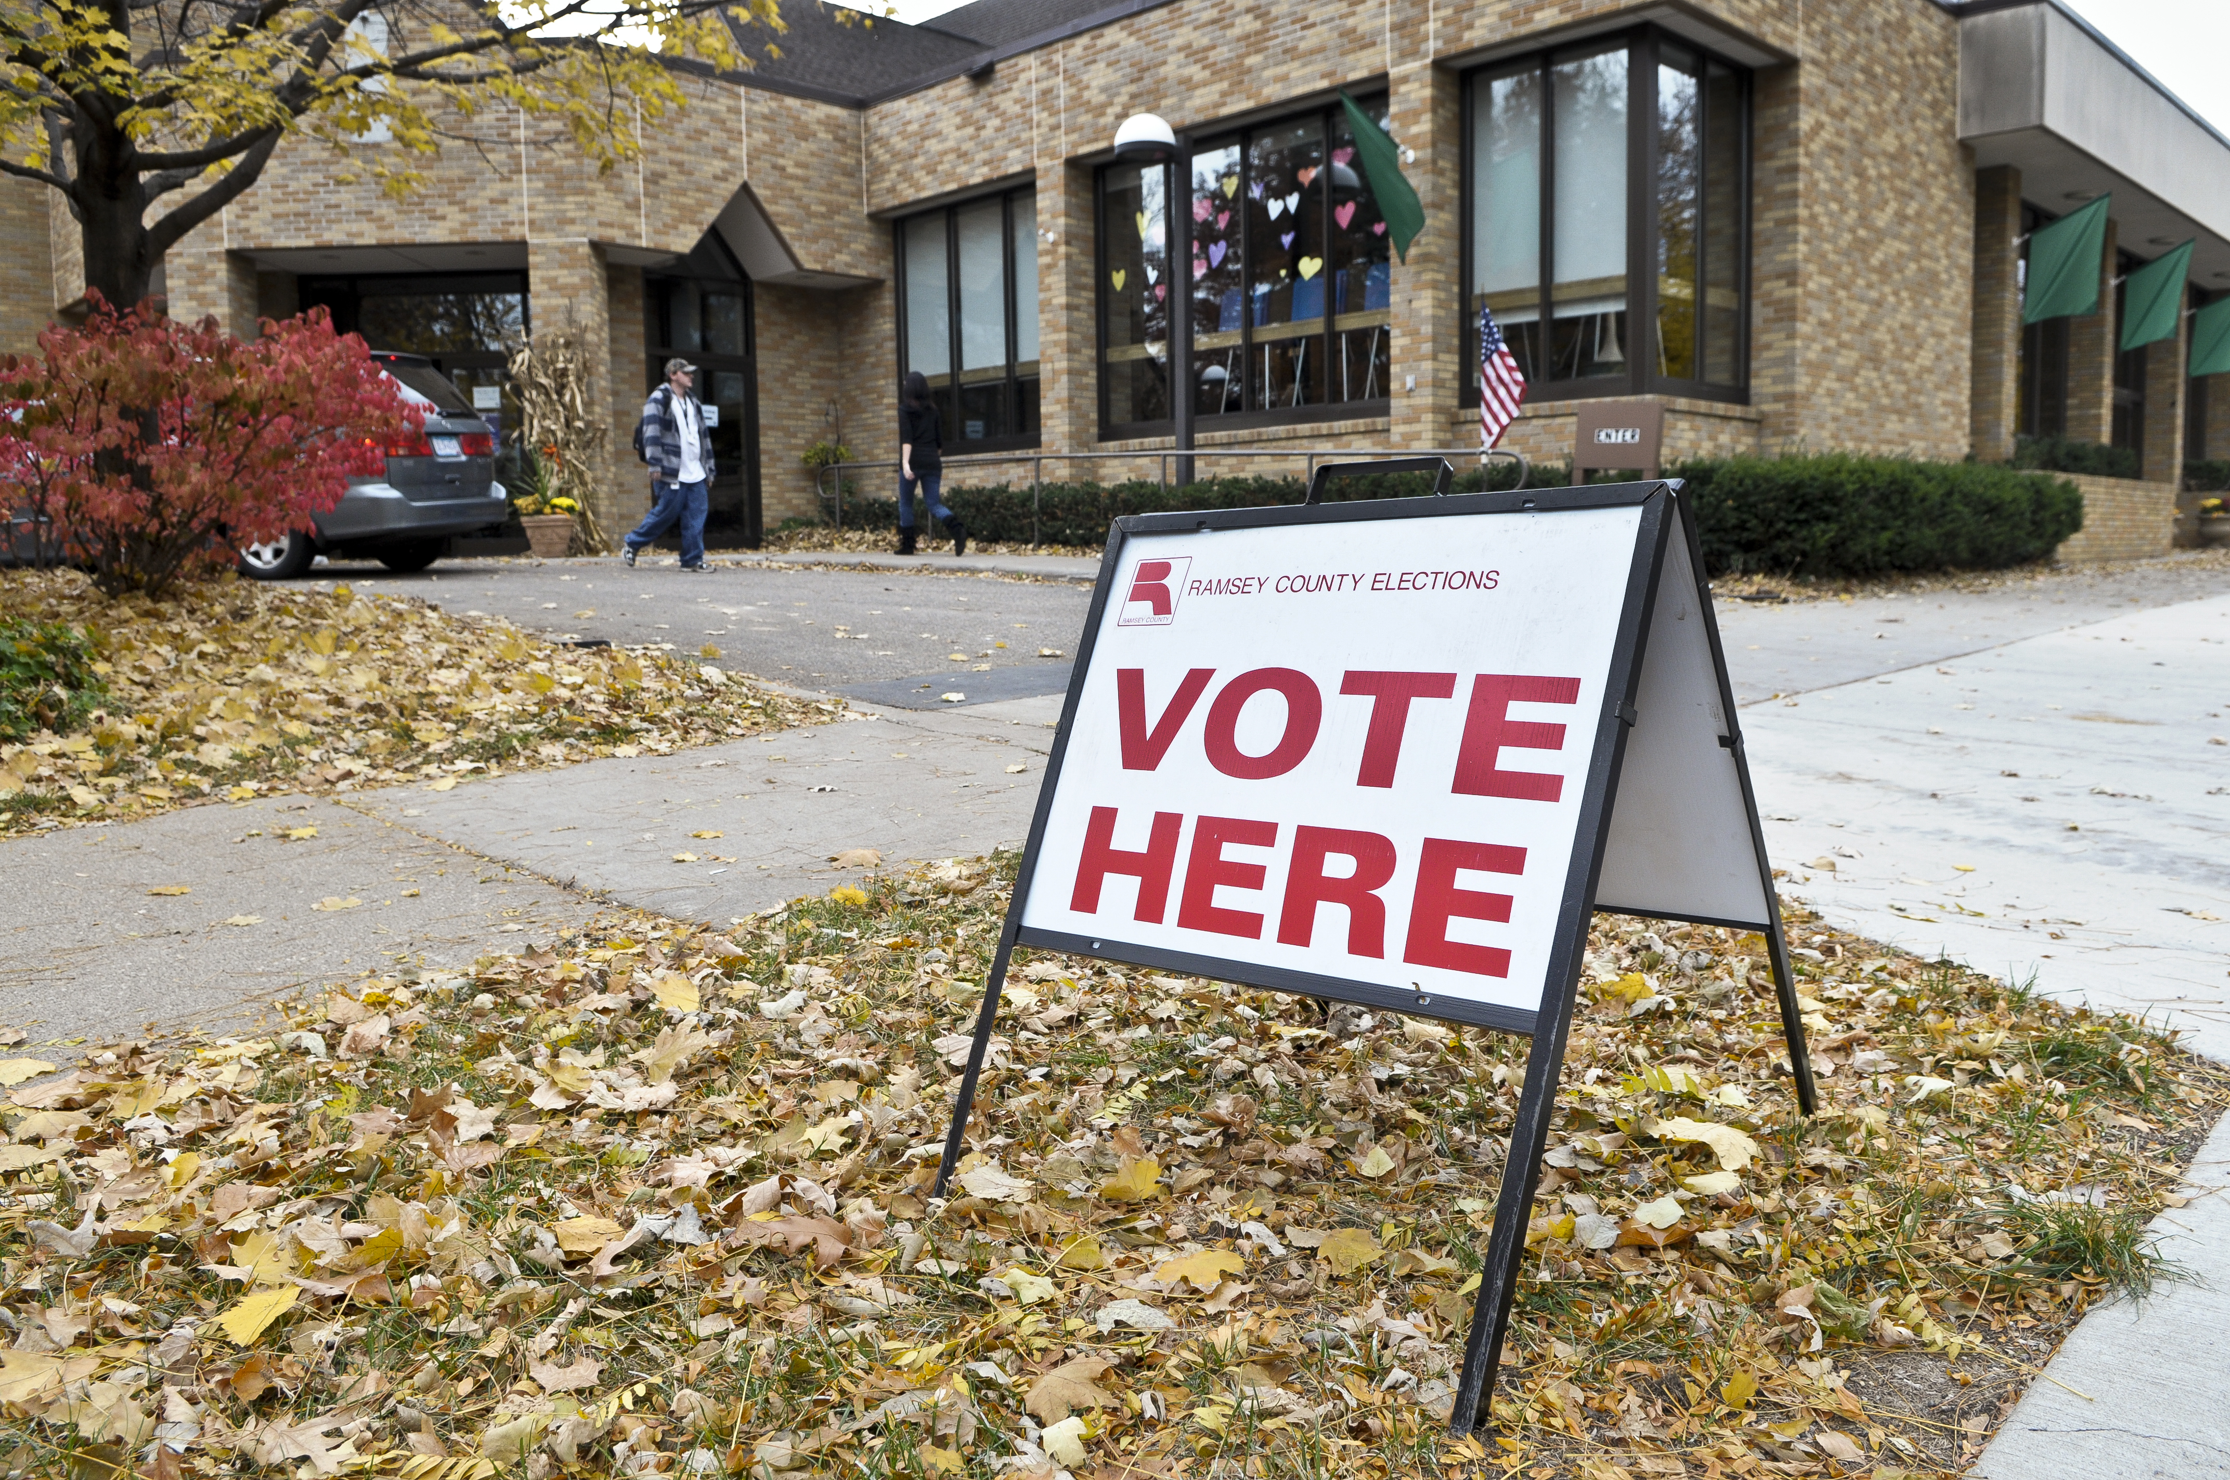
Who can vote in MN?
U.S. citizen
Pre-register at 16 or 17 (Must be 18 to vote)
Resident of Minnesota for at least 20 days
Not currently incarcerated for a felony conviction.
Voters under guardianship can vote unless a judge specifically revoked their right to vote.
BONUS INFO

Slide 9
ELIGIBILITY: Student Election Judges
MN 204B.19
High school students (or home school) age 16+ may be appointed as unaffiliated election judge trainees(until 18).
May not declare a party
Excluded from tasks requiring major party declaration
Serve in their own county or an adjacent county
Work no later than 10 p.m.

Slide 10

Why Be a Student Election Judge?
PAID FOR A LONG DAY AND TWO HOURS OF TRAINING
HELP OTHER USE THEIR VOICE
TIME OFF OF SCHOOL AND WORK
HELP WITH TECHNOLOGY
SEE WHAT REALLY HAPPENS WHEN PEOPLE VOTE

Slide 11

Why Be a Student Election Judge?
LOOKS GREAT ON A COLLEGE APPLICATION
LESSENS ANXIETY FOR YOUNGER VOTERS
LOOKS GREAT ON A JOB APPLICATION
MANY MAKE IT AN ANNUAL EVENT

Slide 12

THE WORK

Slide 13
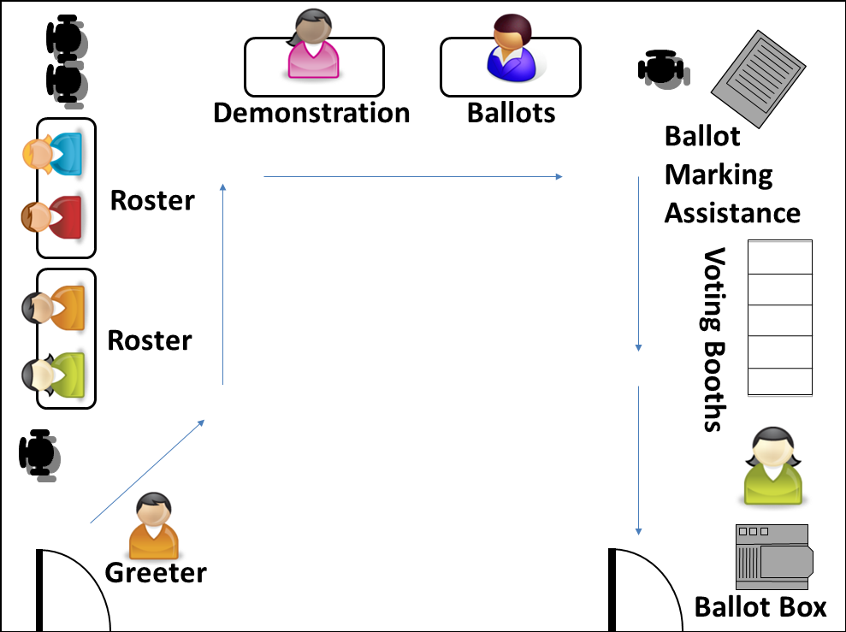

Slide 14
HEAD JUDGE – Assists voters, directs to the correct station, answers questions from election judges.
STATION #1 GREETER – Welcomes and guides voters.
STATION #2 ROSTER JUDGE – Signs in voters who are already registered.
STATION #3 REGISTRATION JUDGE – Conducts Election Day registration for those who need to register.
STATION #4 DEMONSTRATION JUDGE – Explains how to mark the ballot and deliver to ballot counter.
STATION #5 BALLOT JUDGE – Gives ballots to voters.
STATION #6 Voting Booths – Booths set up for privacy so voters can mark ballots in secret.
Ballot Marking Station- Machine that electronically marks ballots.
STATION #7 BALLOT COUNTER JUDGE – Oversees the ballot box area and gives out ‘I VOTED’ stickers.

Slide 15
HOW TO APPLY
County Elections Website
City Clerk Website
Start at Sec. of State Site

Slide 16
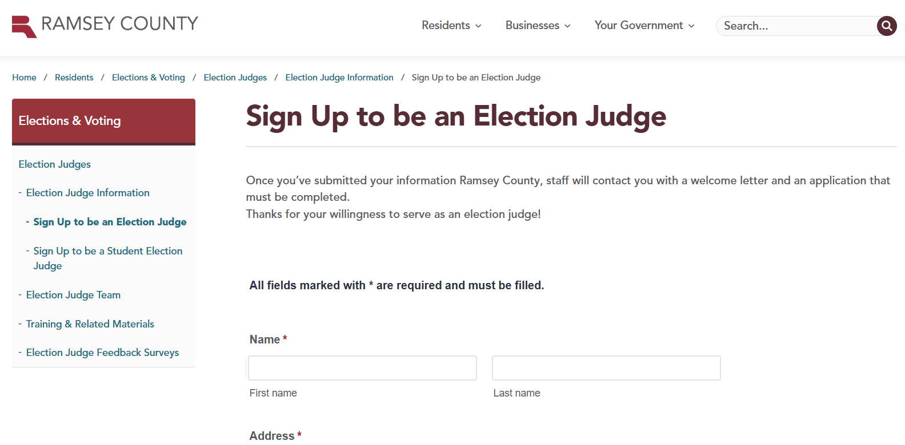
HOW TO APPLY
County Elections Website
City Clerk Website
Start at Sec. of State Site

Slide 17
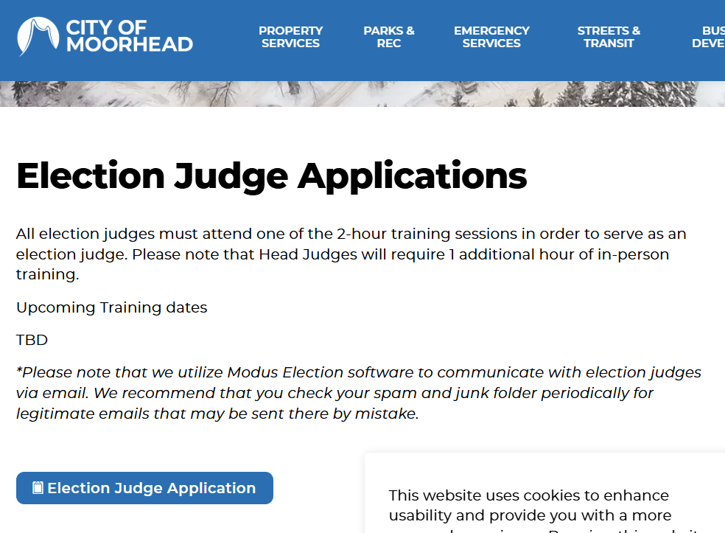
HOW TO APPLY
County Elections Website
City Clerk Website
Start at Sec. of State Site

Slide 18
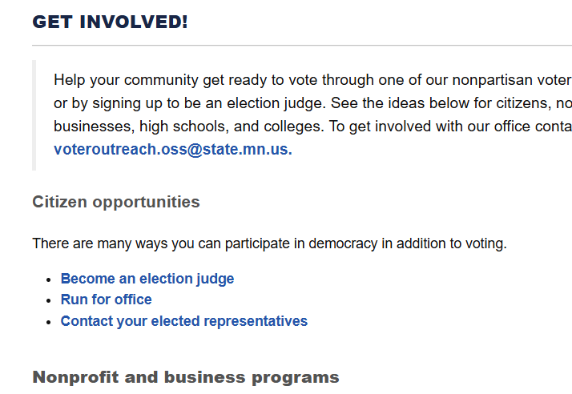
HOW TO APPLY
County Elections Website
City Clerk Website
Start at Sec. of State Site

Slide 19
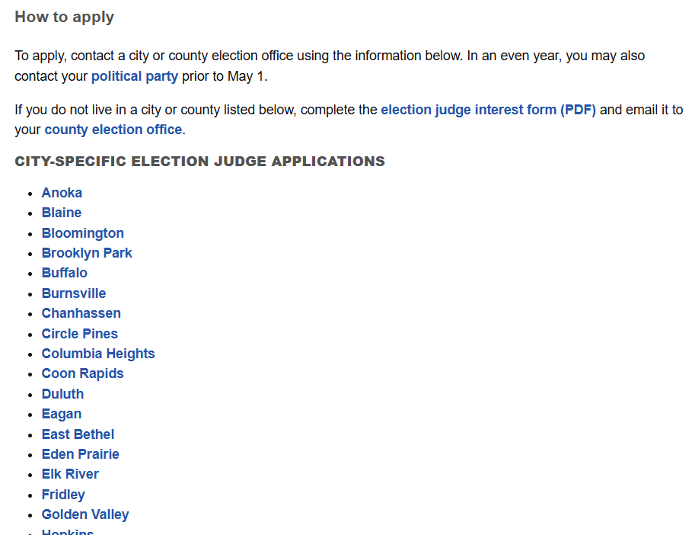
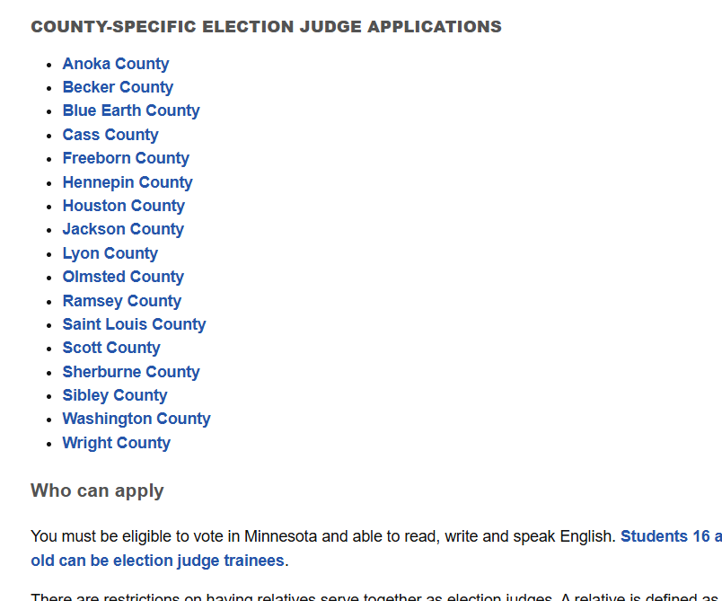
HOW TO APPLY (OSS Website)

Slide 20
What’s it like?
Long day (Sometimes really busy, sometimes really slow. You never know!)
Meet and work with great people.
A real feeling of accomplishment and service.
Neighbors helping neighbors.
Problem solving (with lots of help).
Making other young people more comfortable.

Slide 21
How to prepare for a great experience
Like a test day (get sleep the night before, water bottle, review/study)
Get friends to be SEJ too
Focus. Pay attention. Ask questions, before and on the day
Show up on time (a bit early doesn’t hurt!)
Plan ahead for meals
Let school/work know at least two weeks ahead; let everyone prepare.

Slide 22
Questions? Discussion?
Michael.Wall@State.MN.US
651-201-6892

