Slide 2
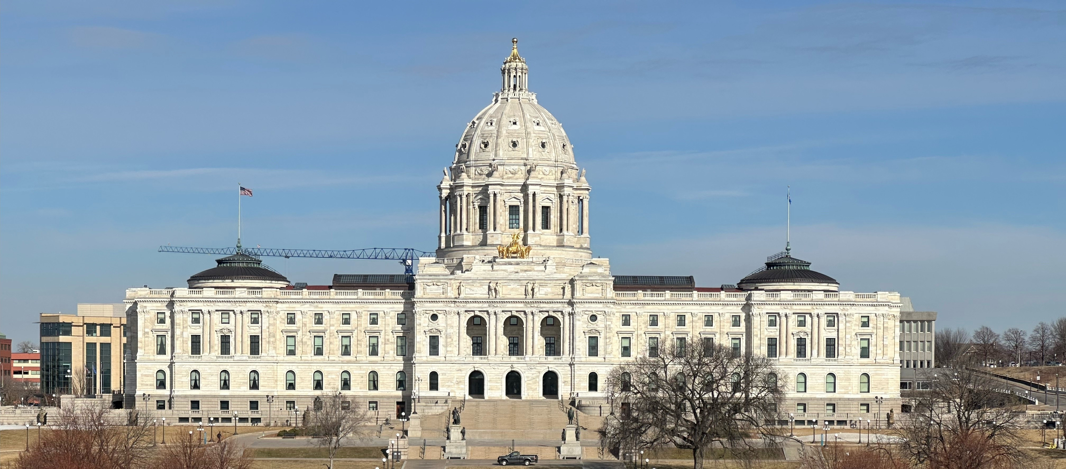
Voting, Advocacy, and Civic Engagement
Before You are 18
-------------

Slide 3
-------------
WE DON’T HAVE ENOUGH TIME

Slide 4
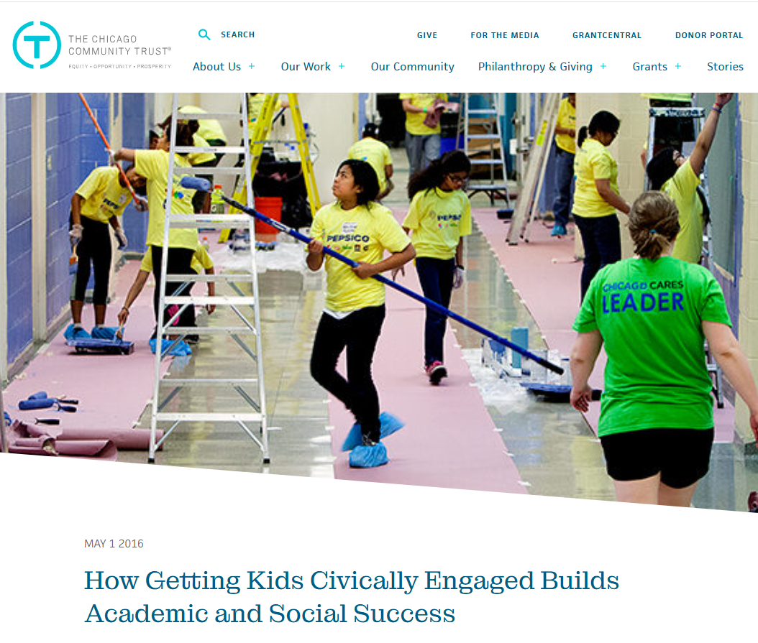
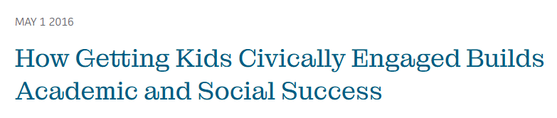

Slide 5
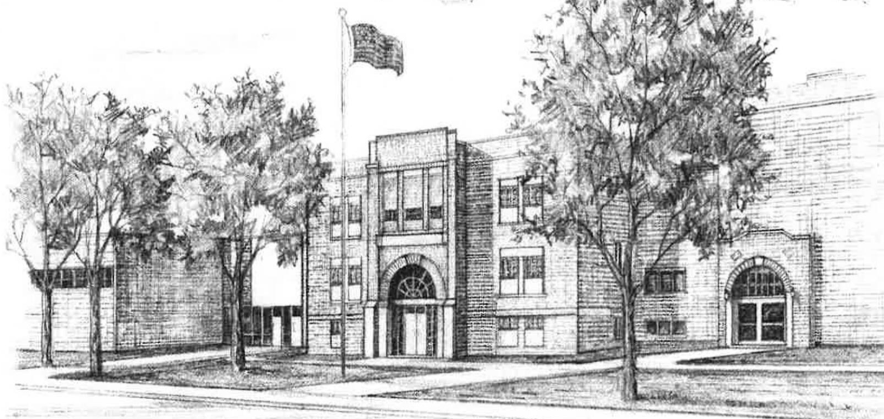
Themes WHILE STILL IN SCHOOL:
Don’t Let Someone Else Make Decisions for You
  Who represents you, what laws they make
  WHAT KIND OF COMMUNITY/COUNTRY YOU LIVE IN
Pizza Analogy
The Power of the Denominator
1=1

Slide 6
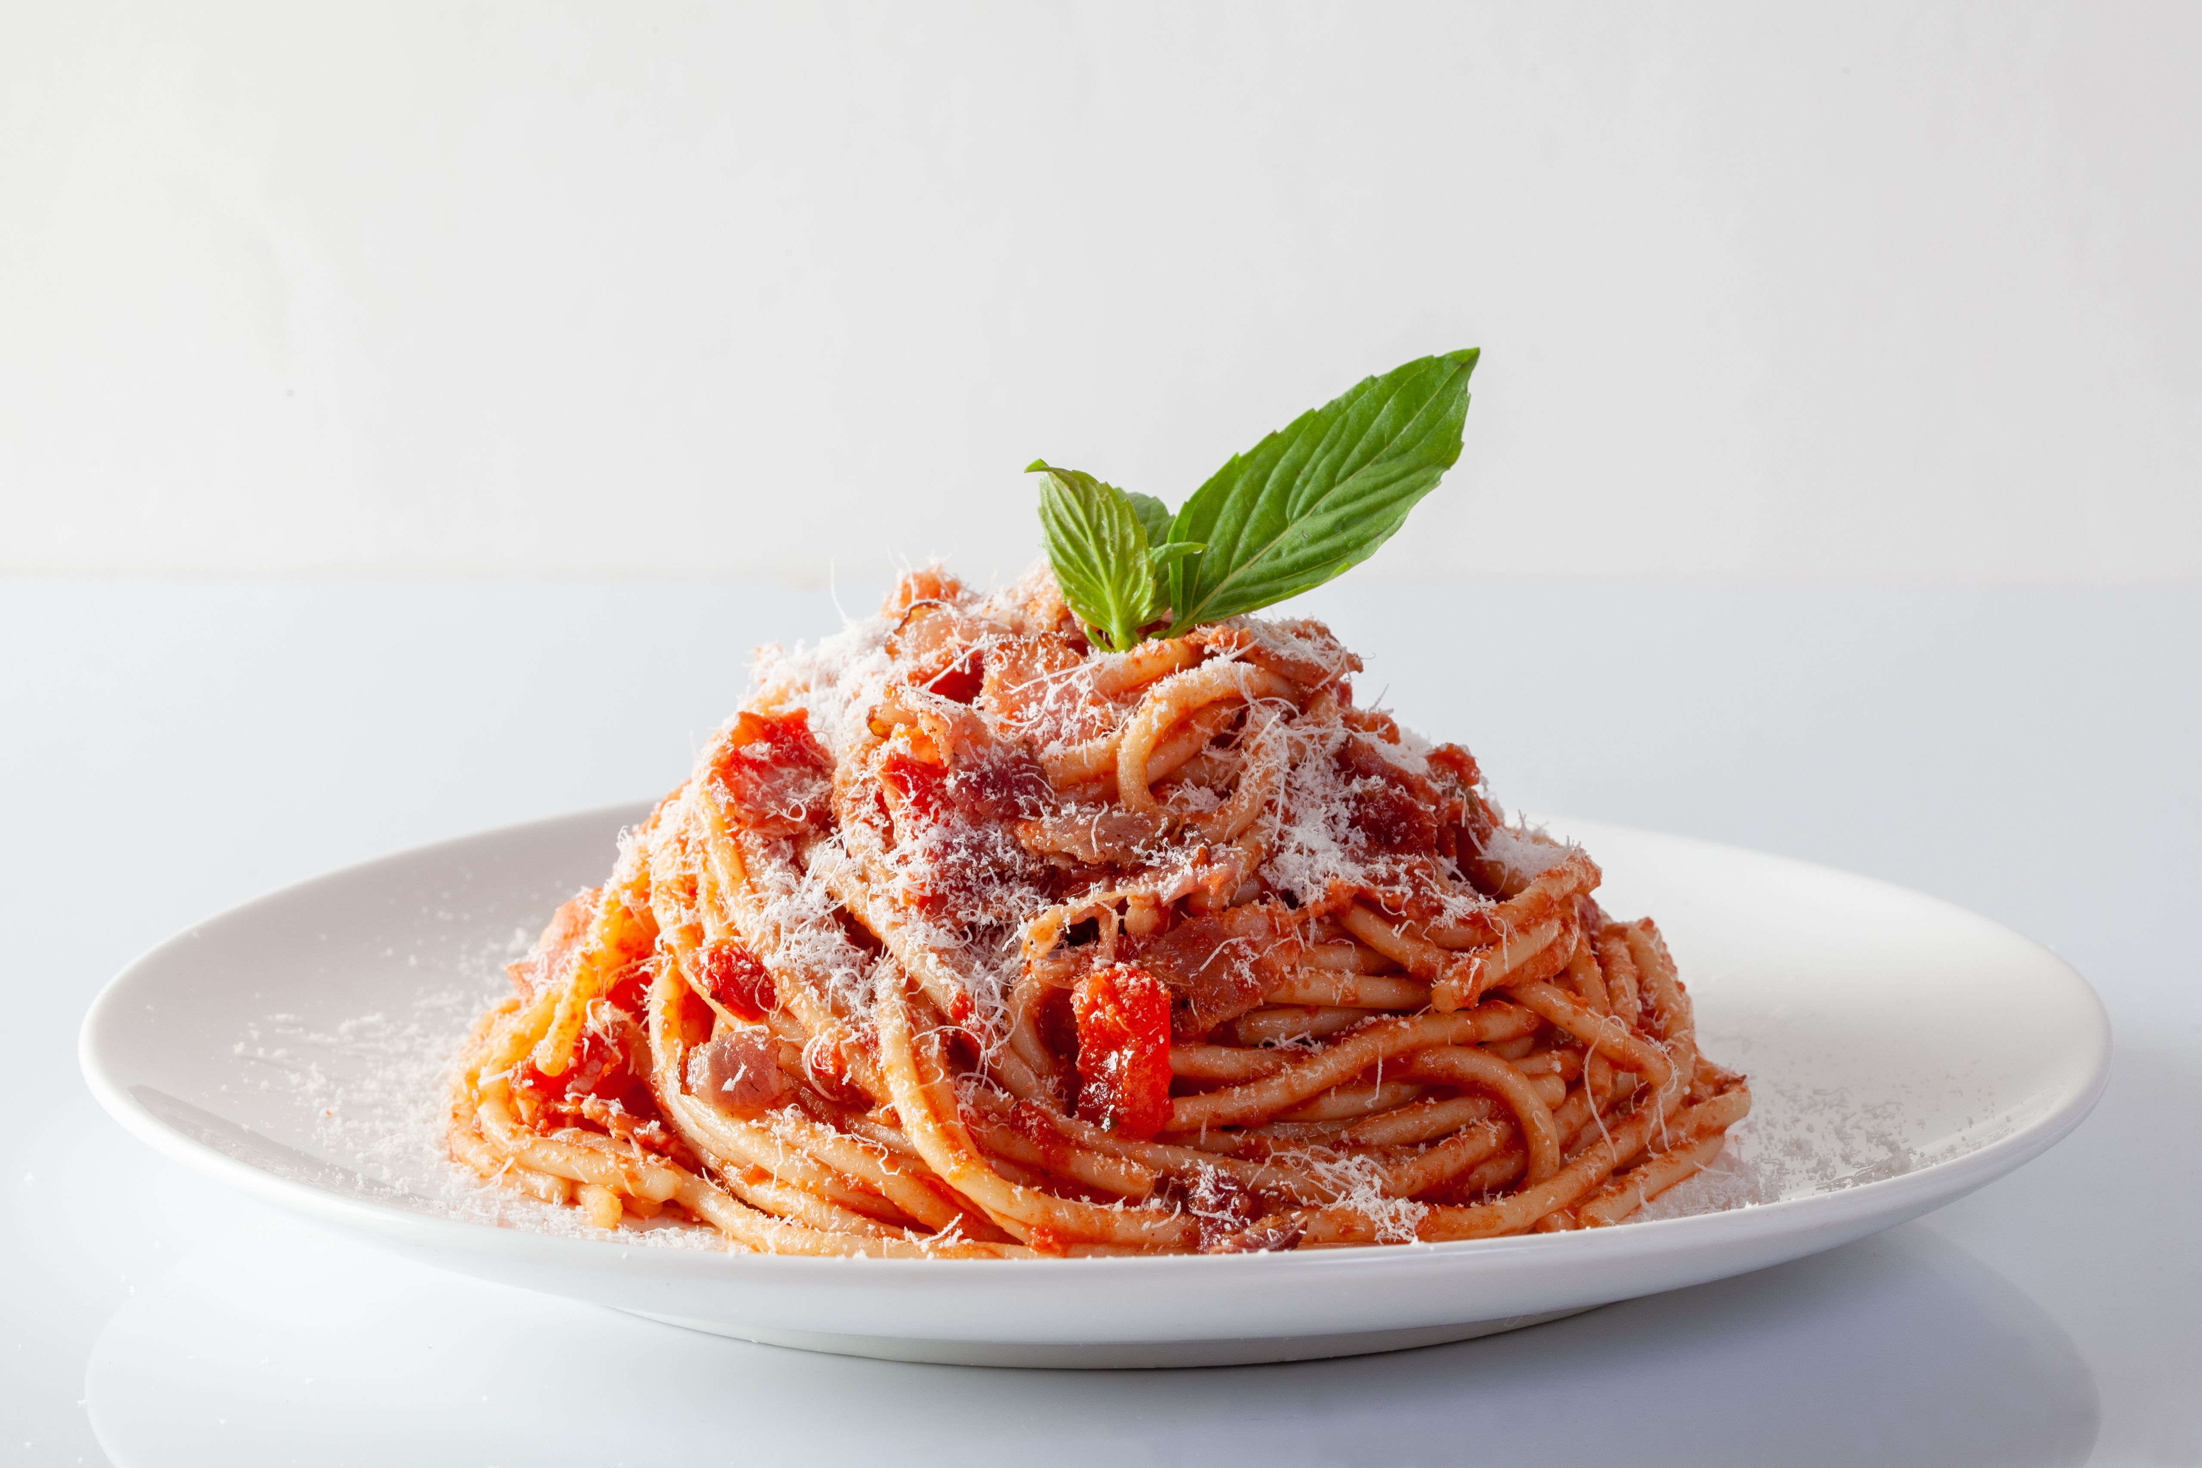
Civic Engagement is not a plated meal.
It’s a…

Slide 7
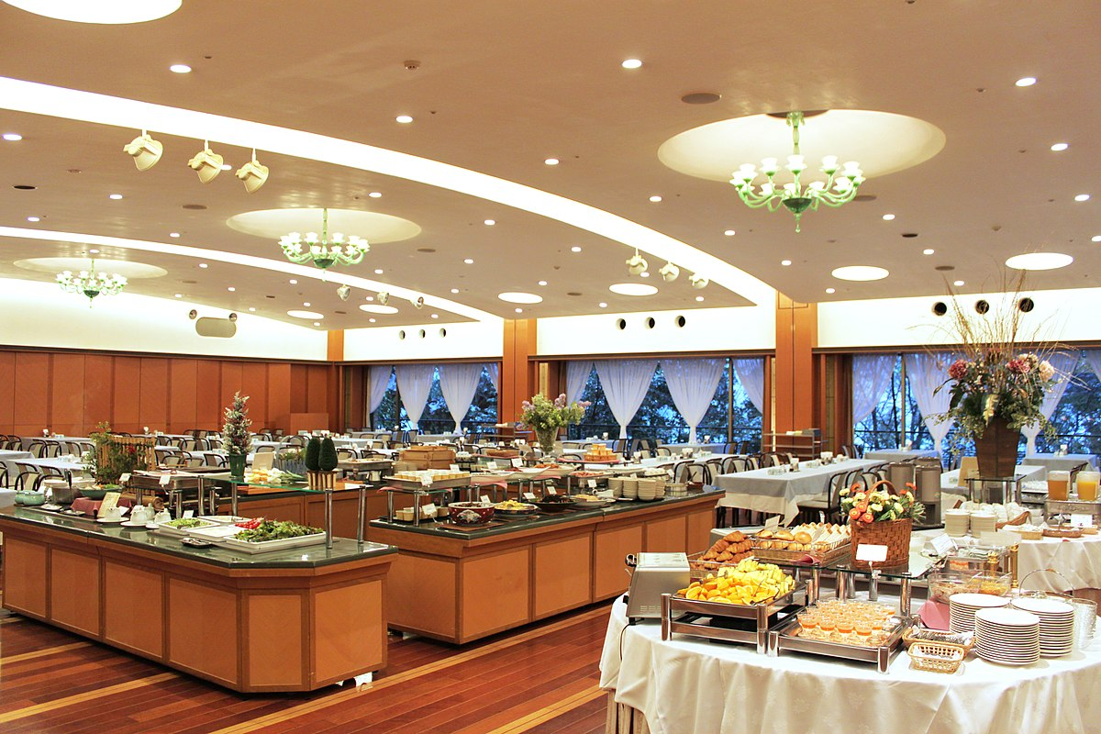
Youth Advocacy Academy
Student Election Judge
Vote16 MN
Minnesota Youth Council
Youth in Government
BUFFET
League of Women Voters Fellows Program
National Voter Registration Day at MN High Schools
Youth Day at the Capitol
Model United Nations
Run a Pre-registration Drive
Students Voting Mock Election
Youth Voter Project
Speak at a School Board Meeting
Project 2076
Volunteer for a campaign
This Photo by Unknown Author is licensed under CC BY-SA

Slide 8
BUFFET
This Photo by Unknown Author is licensed under CC BY-SA

Slide 9
So…for civic engagement before 18,
what’s for dinner?

Slide 10
Let’s Break it Up:
15 and under
16+17 vs. 18+
Type
    Knowledge
    Action
  Effects

Slide 11
Students under 16 years-old can have a lot to learn.

Slide 12
Students under 16 years-old can have a lot to learn.
What is innate?
What is picked-up through exposure?
What is explicitly taught?

Slide 13
Students under 16 years-old can have a lot to learn.
Every exposure to the idea of voting and the mechanics of voting reduces the top two reasons young people report they don’t vote.

Slide 14
Students under 16 years-old can have a lot to learn.
Why Young People Report they Don’t Vote: (CIRCLE, Tufts University)
No one asked me
I don’t want to look stupid
(not a quote)

Slide 15
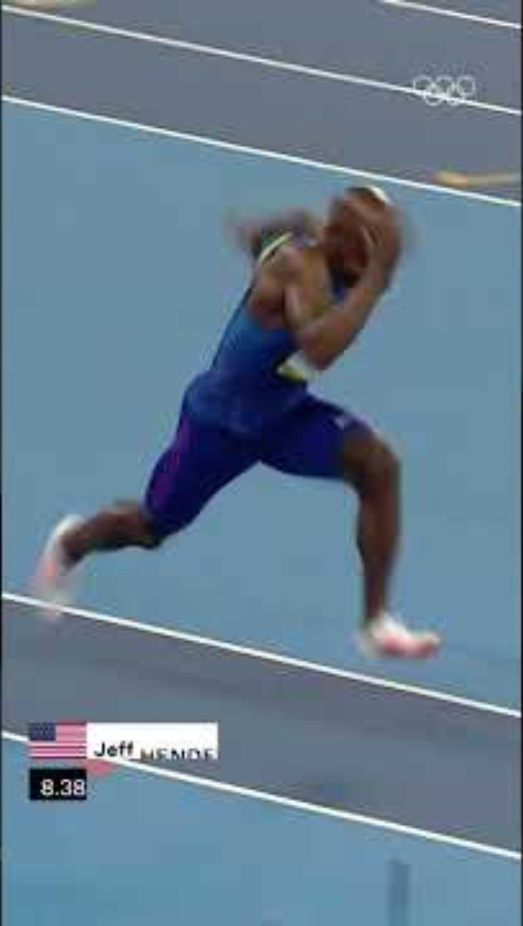
16 and 17 year-olds can have a lot of impact, and can gain lots of momentum.

Slide 16
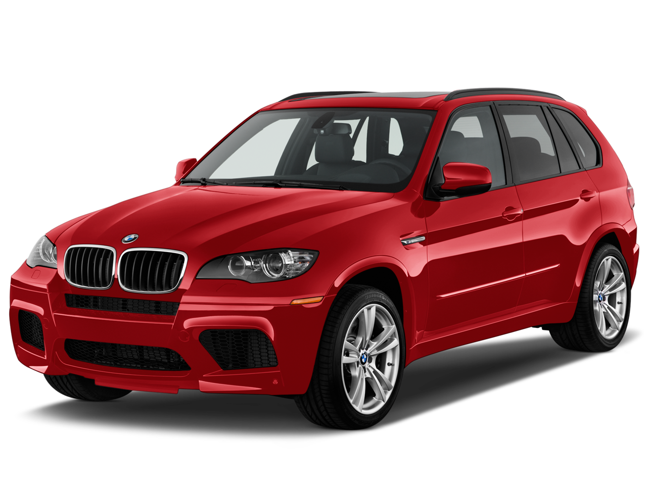
16 and 17:
Preregister to Vote!
    Be in the cue (automatic at 18)
    Increase awareness
    Vote in higher percentages
    Voting 1st time=Lifetime
This Photo by Unknown Author is licensed under CC BY-NC

Slide 17
16 and 17:
Volunteer!
    Campaigns
    Voter (pre) Registration Drives
      In the community
      At your school
    Help run voter education programs
      Students Voting Mock Election
      NVRD in MN High Schools
      Youth Day at the Capitol

Slide 18
16 and 17:
Get Paid!
    Election Judge Trainees
      A full day and two hours paid training
      Out of school
      Great on a resume/application
      ‘See how the sausage is made’
      *Vast majority come back to do it again!

Slide 19
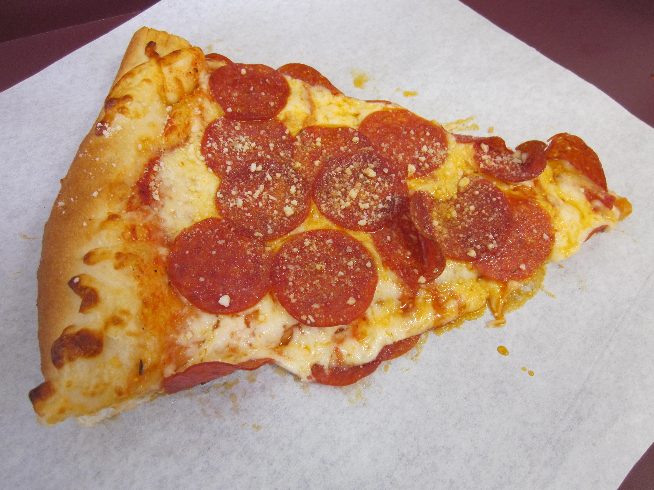
18 and Older:
Register to vote!
    It’s required to vote
    The Big Difference! (18-24 vs. 24+ in 2020)
      Not percentage of registered who turn out…
      Percentage of eligible who register! (86 v 92)
    Decisions are made by those who show up
    Reps listen to voters
This Photo by Unknown Author is licensed under CC BY-SA

Slide 20
18 and Older:
That other stuff!
    Volunteering
    Election Judge (WITH Party Declaration)

Slide 21
Everyone:

Slide 22
Learn the Process:
Example!
    Tell them (goals, type of person, choices)
    Show them (point out, praise)
    Take them with (volunteering, voting, meetings)
    Assign (Learn by doing, like chores)
      Helping ‘around the community’
      Connect to allowance, etc.)

Slide 23
Learn the Process:
Study 1
    Learning the how (mechanics) leads to much higher rates of voting the first time you become eligible

Slide 24
Learn the Process:
Study 2
    Voting the first time you become eligible leads to much higher rates of lifelong voting.

Slide 25
Learn the Process:
KNOW:
    Yourself (learn what you care about)
    The Issues (What are laws controlling?)
    What you think about the issues (see #1)
    Who is running? (What’s on My Ballot)
    Which candidates most closely match you

Slide 26
Learn the Process:
ADVOCATE:
  Before and after they are elected, they need to hear from you. (Letters, Email, Phone Calls; Petitions; Visits…)
  Who Represents Me?
  Two Schools:
  Elect to follow you, or elect to do the best job they can

Slide 27
Learn the Process:
Registering/Pre-registering:
  Long
  Difficult
  Hard to Understand

Slide 28
Learn the Process:
Registering/Pre-registering:
  Long
  Difficult
  Hard to Understand
NOT AT ALL

Slide 29
Learn the Process:
(pre)Registering:
  5 pages
  All about you
  Things you know

Slide 30
https://www.sos.state.mn.us/elections-voting/get-involved/the-online-pre-registrationstar-form-page-by-page/

Slide 31
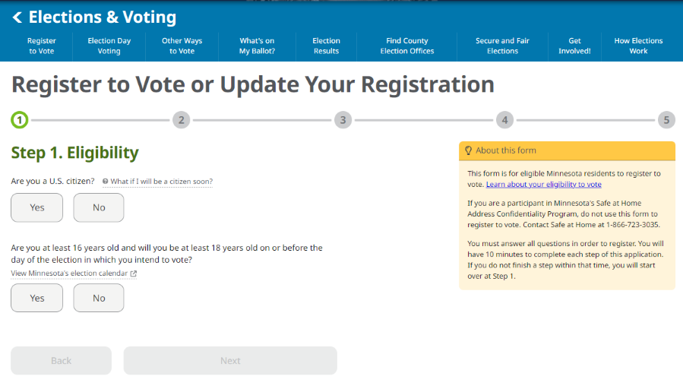

Slide 32
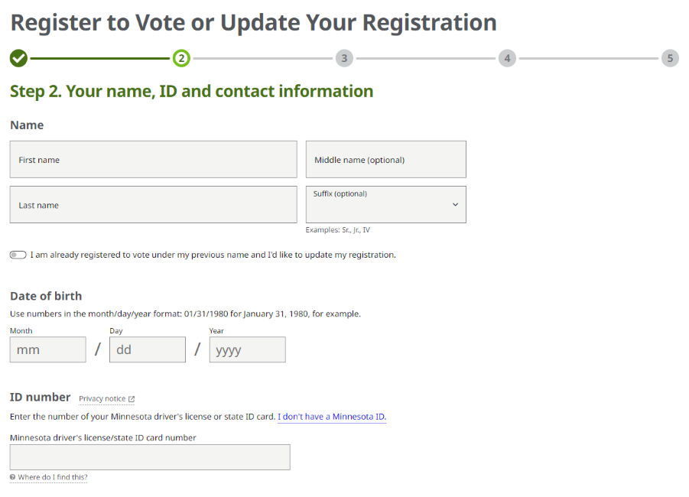

Slide 33
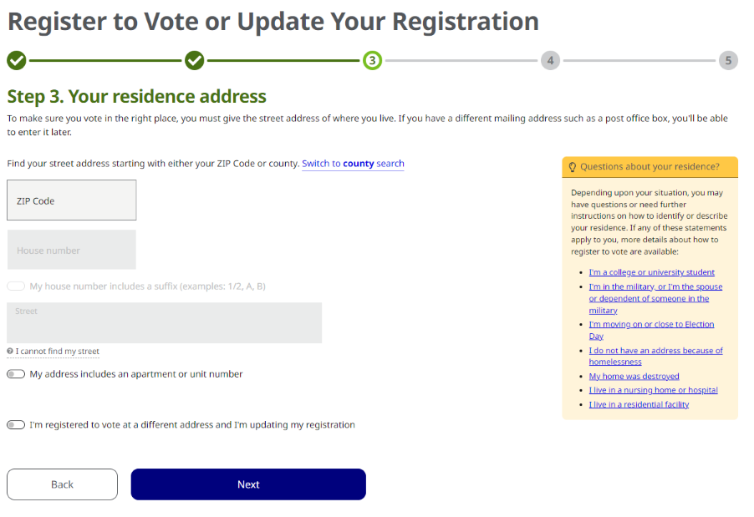

Slide 34
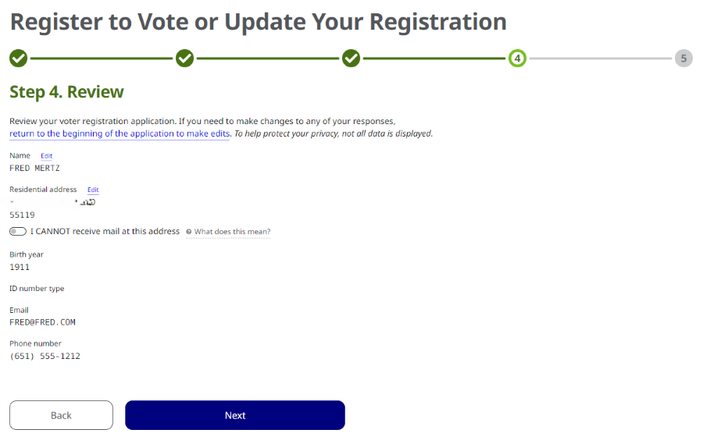

Slide 35
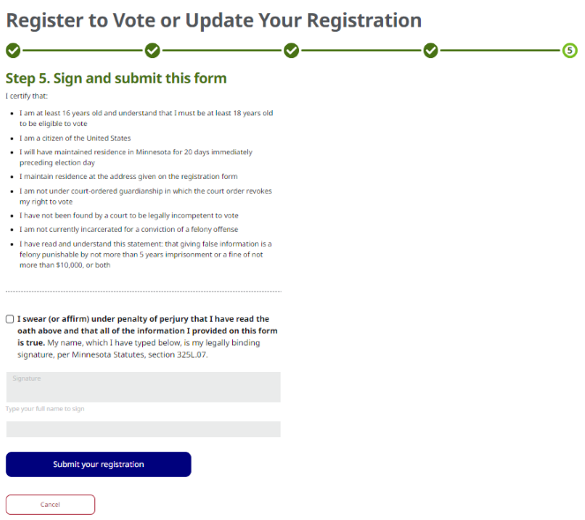

Slide 36
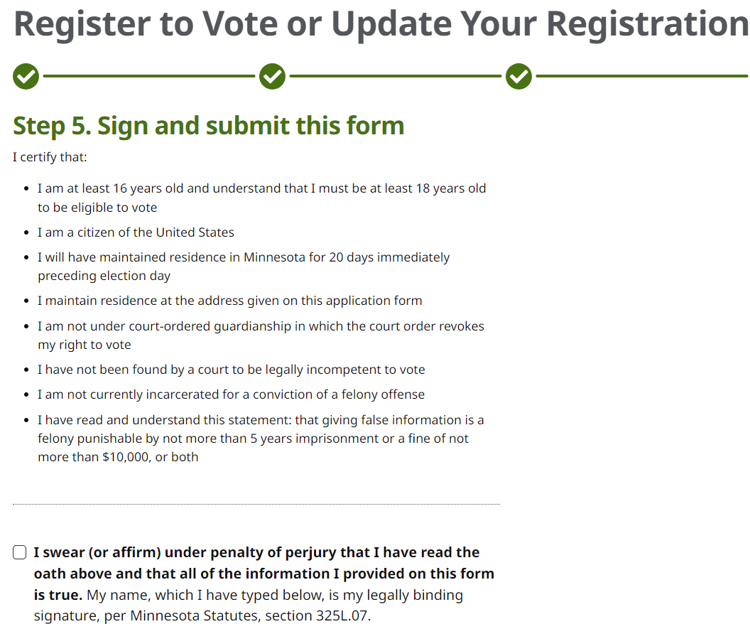

Slide 37
THAT’S IT!

Slide 38
How About
the Ballot?

Slide 39
Ever taken
a standardized test?

Slide 40
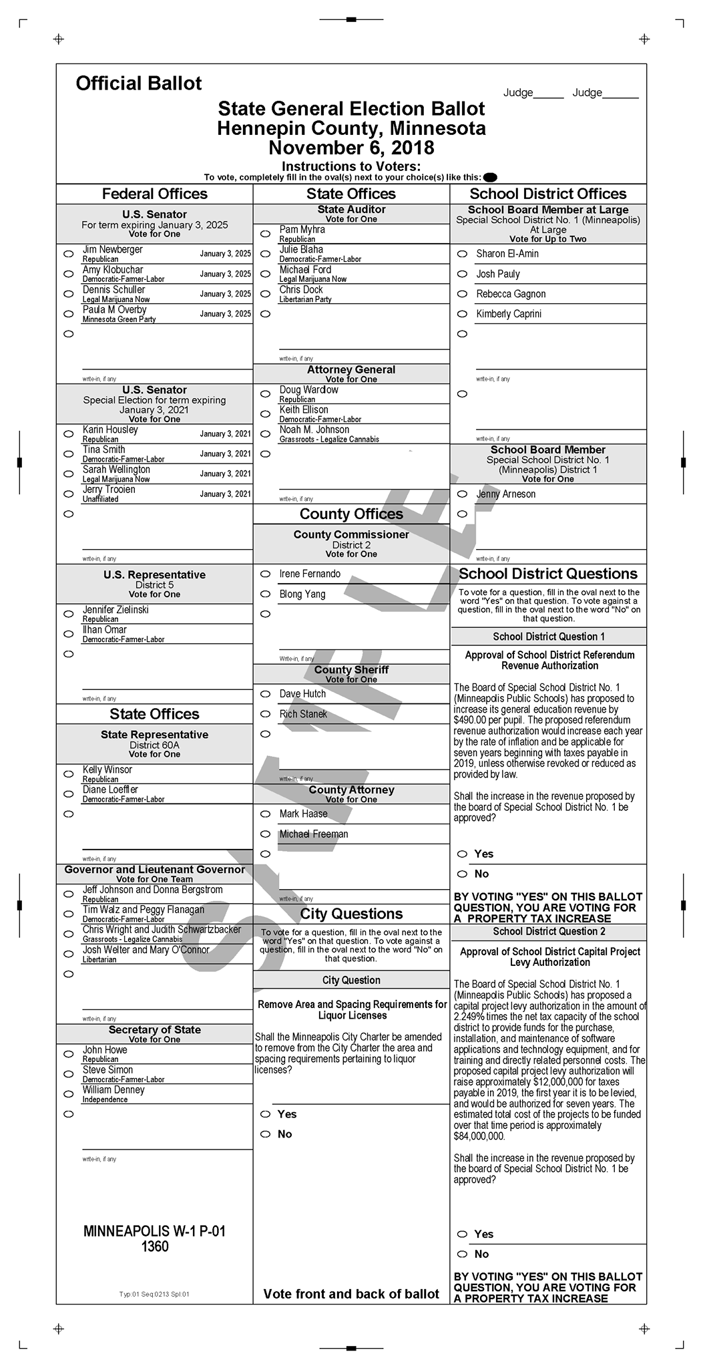

Slide 42
How About
a Polling Place?

Slide 43
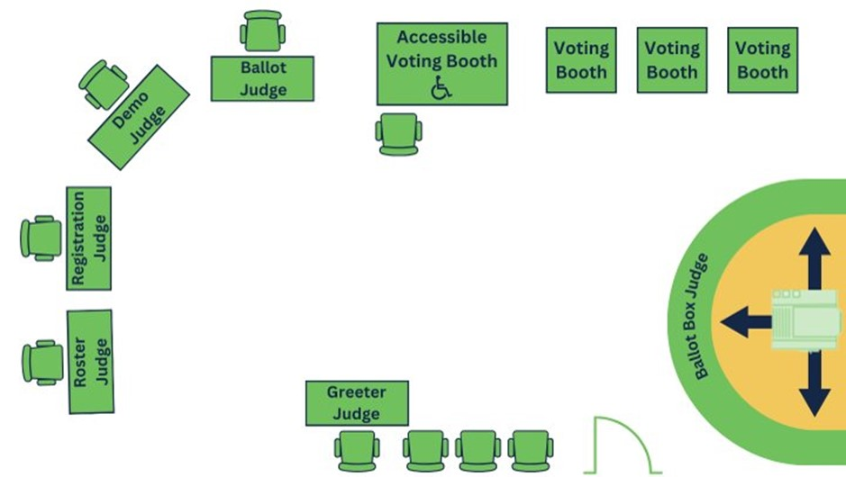

Slide 44
QUESTIONS?

Slide 45
www.sos.state.mn.us/elections-voting/get-involved
Michael Wall
Michael.Wall@state.mn.us
651-201-6892

