Slide 1


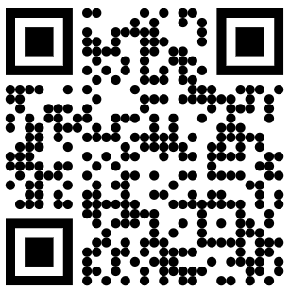
The public hearing presentation will begin shortly.
Thank you for your patience.
To join the hearing by WebEx (video):
Go to: https://minnesota.webex.com/minnesota or scan this QR code
Enter meeting number (access code): 2497 428 6333
Password: i7nWuZXmc55
To join the hearing by telephone (audio only):
Call 1-415-655-0003
Enter Access Code: 2497 428 6333

Slide 2
Public Hearing – October 10, 2025
Proposed Permanent Rules Relating to Elections Administration; Revisor’s ID Number R-4824
CAH Docket No. 8-9019-39440

Slide 3
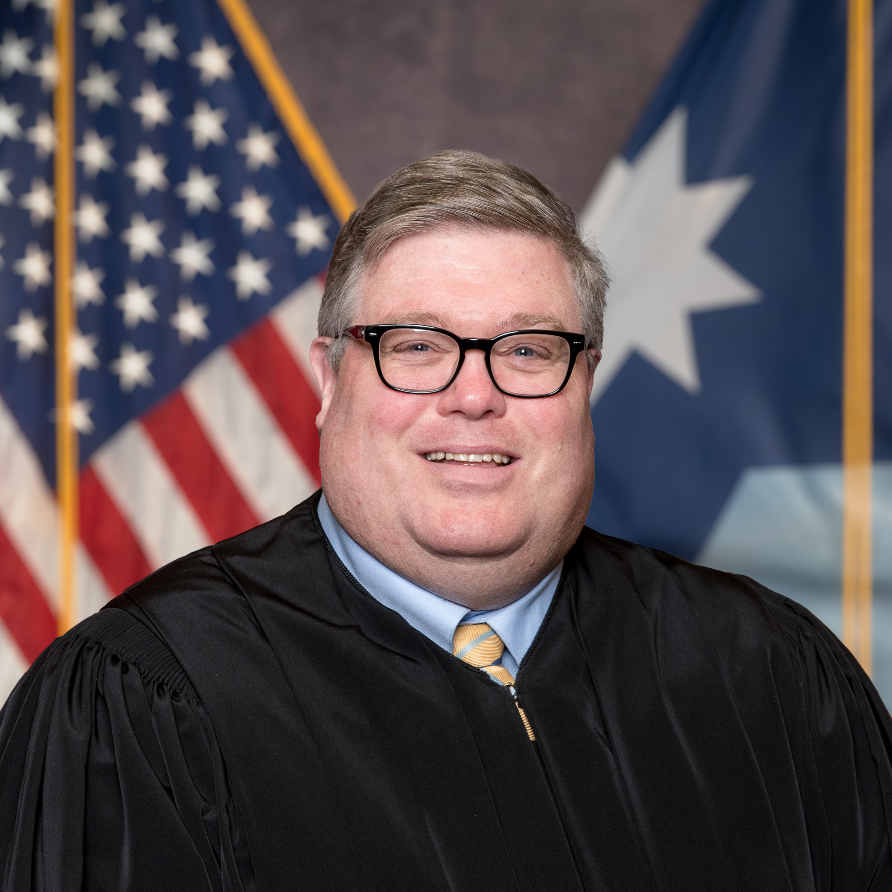

Introduction
Administrative Law Judge
Eric L. Lipman
CAH renders justice through fair, timely, and impartial hearings and high-quality dispute resolution services.
CAH is independent from the Minnesota Secretary of State and all other parties to this proceeding.
Hearing Purpose: To allow the agency to present its reform proposals and to receive public comments on those proposed changes.

Slide 4

Your Participation Matters
Public participation in the rulemaking process is essential to the development of fair and thoughtful public policy.
Thank you for contributing your thoughts, experience, and expertise.

Slide 5

Key Issues for Our Hearing
Does the Agency have legal authority to adopt the rules?
Has the Agency fulfilled all relevant legal and procedural requirements to promulgate the rules?
Has the Agency demonstrated the need and reasonableness of each portion of the proposed rules?

Slide 6

Roadmap for Today
My remarks
Introduce panel
Agency exhibits and presentation
Public questions and comments

Slide 7
Agency Panel
Justin R. Erickson, General Counsel

Slide 8

Agency Exhibits
Agency exhibits from this hearing are available to view at:
https://www.sos.mn.gov/about-the-office/rulemaking-data-practice/elections-rulemaking-2025-2026/
OR https://tinyurl.com/9019-39440

Slide 9
Ways to Comment
(1) Offer oral comments at this hearing
(2) Offer written comments electronically, by mail, or by fax
(3) Electronically at: https://minnesotaoah.granicusideas.com/discussions
(4) By U.S. mail to:
    Court of Administrative Hearings
    Attn: Docket No. 8-9003-37102
    P.O. Box 64620
    St. Paul, MN 55164-0620
(5) By Fax to 651-539-0310

Slide 10

Preferred Method for Written Comments
eComments is the preferred method for submitting written comments
Review CAH’s website: https://mn.gov/oah/media/rulemaking.jsp for step-by-step instructions on submitting eComments

Slide 11
Presenting Oral Comments
In WebEx
By Telephone
At the bottom right side of your computer screen, click on the chat icon.
Type your first and last name in the chat to request to speak.
Chat will go directly to the Host, who will put you in queue in the order received. When it is your turn, you will be prompted to unmute your microphone.
Press *3 on your keypad to raise your hand (and *3 to lower) to indicate your interest in making a comment.
The WebEx operator will place you into a queue in the order received and will say the first 6 digits of your phone number when it is your turn, and you will be unmuted.
State and spell your first and last name for the record before commenting.

Slide 12
Process for Presenting Oral Comments
For those attending by WebEx, turn on your video by clicking the video icon.
To ensure everyone is heard, please try to limit your initial comments to 5 minutes.
You may return to the queue to speak again, time permitting. (Preference will be given to those who have not spoken yet.)
Our objective during the hearing process is to hear from as many different people, and on a wide a range of topics, as our time together permits.

Slide 13
Remember – Other Ways to Comment
You may also submit written comments by eComments, mail, or fax.
If you are unable to comment today, please know that all comments are considered in the same way regardless of the way they are submitted.

Slide 14

Tips for Oral Comments
State and spell your first and last name
If you are commenting on behalf of an organization, identify the organization
Speak slowly, clearly, and loudly - only audible statements will be recorded
Spell names and technical terms
Introducing an acronym? Be sure to state the full phrase

Slide 15
Time for Comments
Initial comment period closes
Thursday, October 30, 2025
Comments must be received by 4:30 p.m. on that day

Slide 16

Time for Rebuttal
5 business days from the close of the initial comment period
Rebuttals must be received by 4:30 p.m. on Thursday
November 6, 2025
Rebuttal is a reply to something someone else said - not a new comment.

Slide 17

Judge’s Report
Judge will issue a report
Within 30 days of the close of the record, unless extension is granted
You can view the report at https://mn.gov/oah/media/opinion-archive.jsp
OR https://tinyurl.com/OAH-Archive
Report will be posted on the day it is issued.

Slide 18

Required Reminder for Lobbyists
Lobbyists must register with the Campaign Finance and Public Disclosure Board.
Questions about registration should be directed to that Board
www.cfb.mn.gov

Slide 19
Agency Panel

Slide 20
Public Questions and Comments
Administrative Law Judge
Eric L. Lipman
In WebEx, put your name in the CHAT box to request to speak and be placed in the queue
OR
Press *3 on your telephone to add yourself to the comment queue
Press *3 again to remove yourself from the queue

Slide 21

Comment Deadline Reminder
Initial comments must be received by
4:30 p.m. on
Thursday, October 30, 2025
Rebuttals must be received by
4:30 p.m. on
Thursday, November 6, 2025
Docket No. 8-9019-39440

Slide 22
Thank you!
mn.gov/cah

