Slide 2
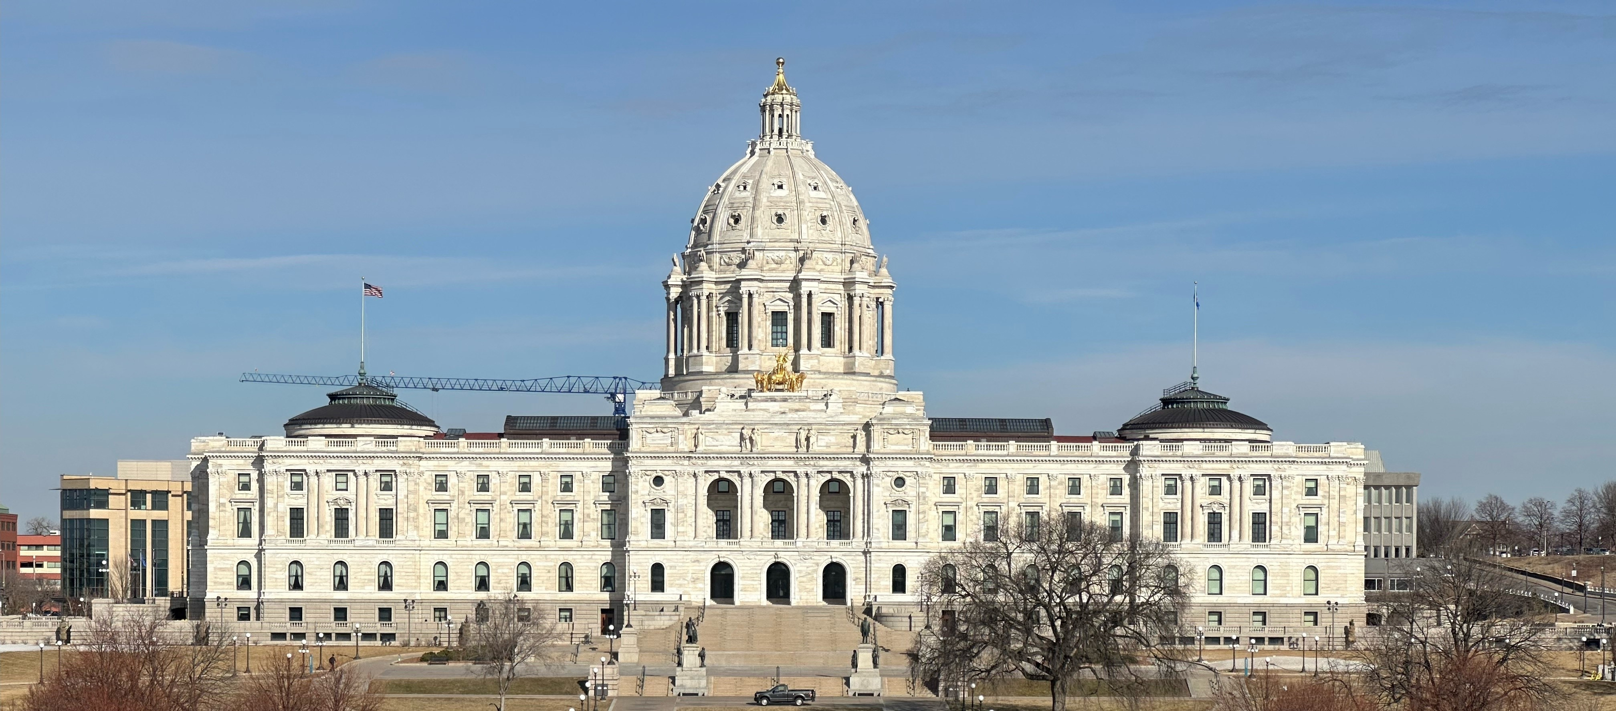
Voting, Advocacy, and Civic Engagement
Before You are 18
-------------

Slide 3
-------------
WE DON’T HAVE ENOUGH TIME

Slide 4
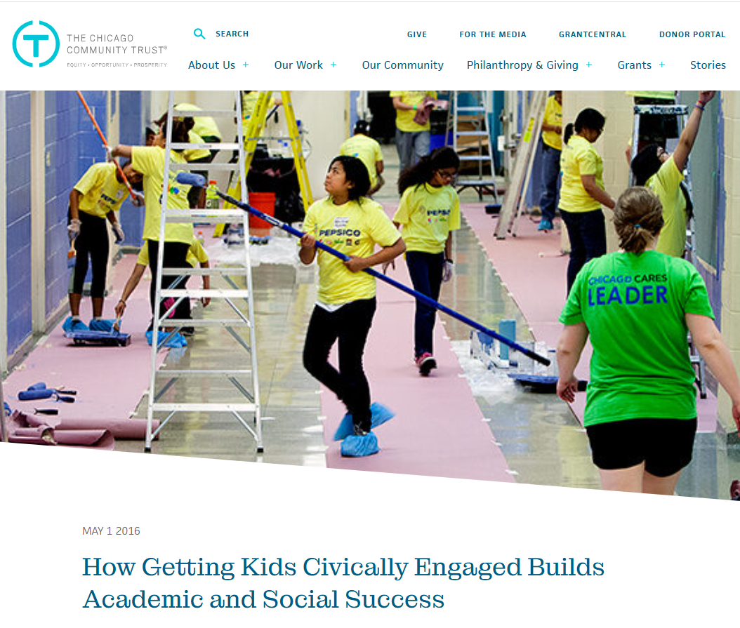
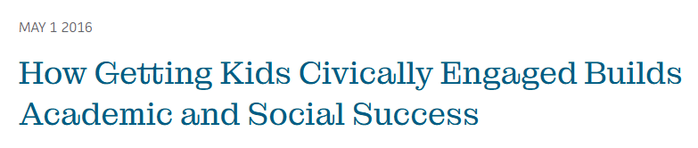

Slide 5
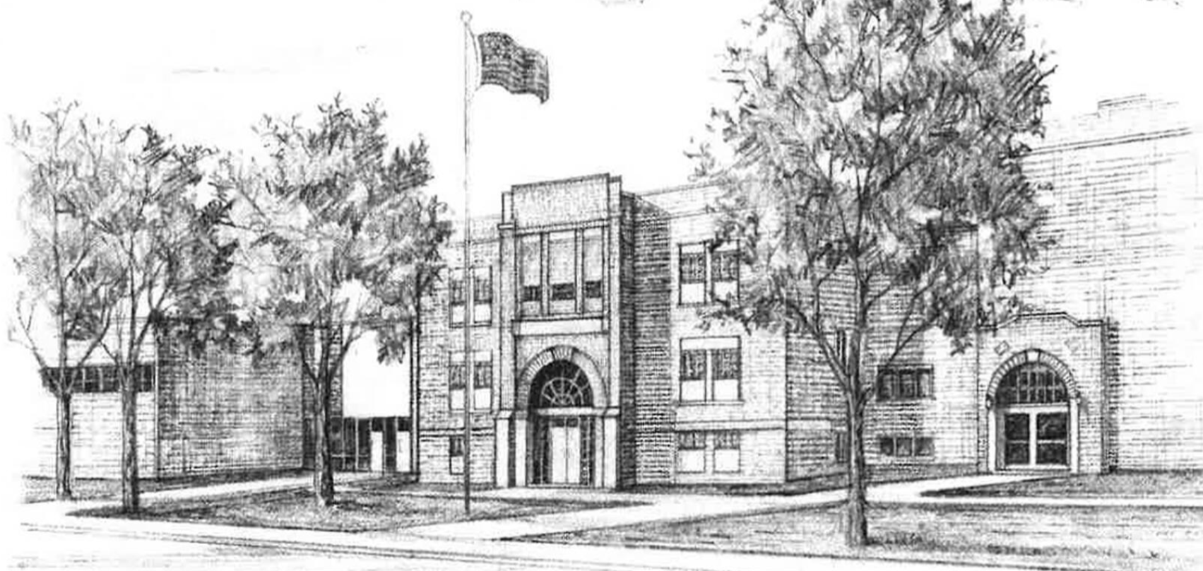
Themes WHILE STILL IN SCHOOL:
Don’t Let Someone Else Make Decisions for You
Who represents you, what laws they make
WHAT KIND OF COMMUNITY/COUNTRY YOU LIVE IN
Pizza Analogy
The Power of the Denominator
1=1

Slide 6
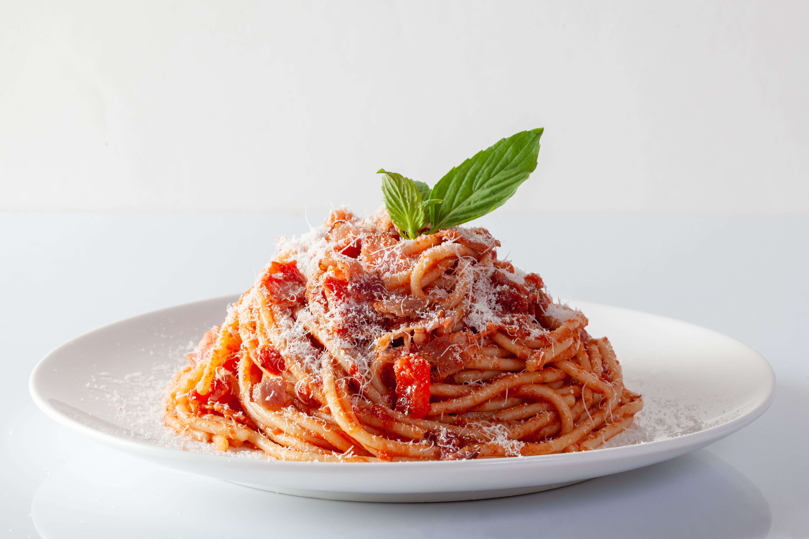
Civic Engagement is not a plated meal.
It’s a…

Slide 7
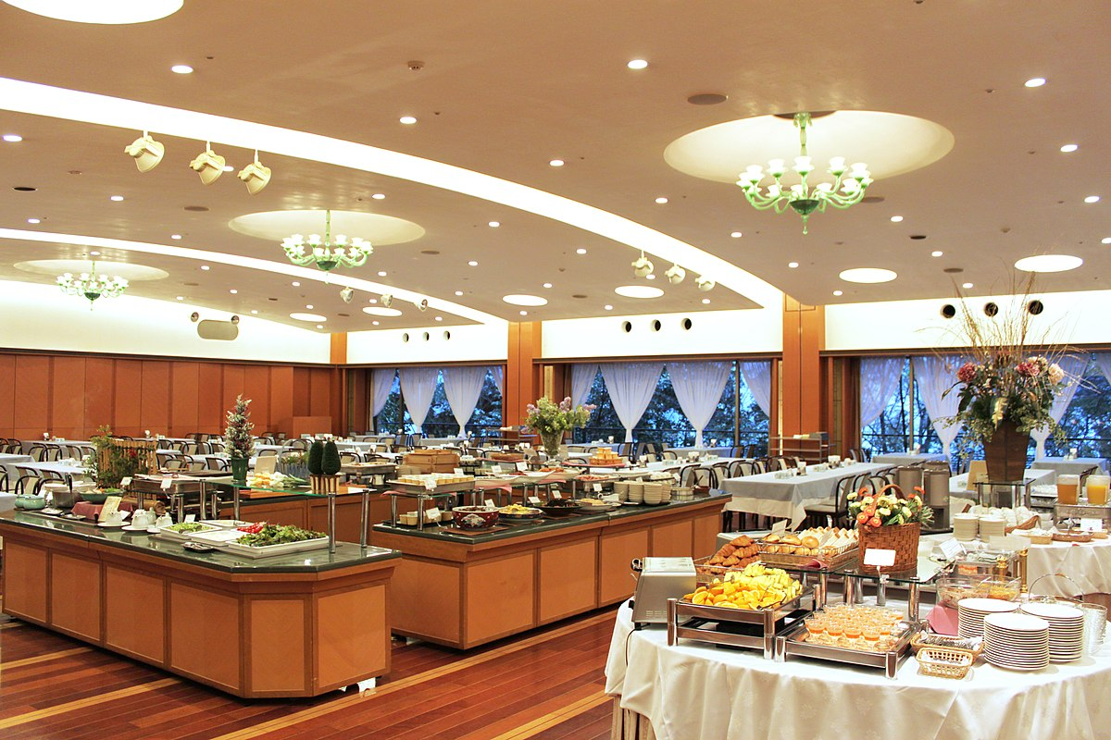
Youth Advocacy Academy
Student Election Judge
Vote16 MN
Minnesota Youth Council
Youth in Government
BUFFET
League of Women Voters Fellows Program
National Voter Registration Day at MN High Schools
Youth Day at the Capitol
Model United Nations
Run a Pre-registration Drive
Students Voting Mock Election
Youth Voter Project
Speak at a School Board Meeting
Project 2076
Volunteer for a campaign
This Photo by Unknown Author is licensed under CC BY-SA

Slide 8
BUFFET
This Photo by Unknown Author is licensed under CC BY-SA

Slide 9
So…for civic engagement before 18,
what’s for dinner?

Slide 10
Let’s Break it Up:
15 and under
16+17 vs. 18+
Type
Knowledge
Action
Effects

Slide 11
Students under 16 years-old can have a lot to learn.

Slide 12
Students under 16 years-old can have a lot to learn.
What is innate?
What is picked-up through exposure?
What is explicitly taught?

Slide 13
Students under 16 years-old can have a lot to learn.
Every exposure to the idea of voting and the mechanics of voting reduces the top two reasons young people report they don’t vote.

Slide 14
Students under 16 years-old can have a lot to learn.
Why Young People Report they Don’t Vote: (CIRCLE, Tufts University)
No one asked me
I don’t want to look stupid (not a quote)

Slide 15
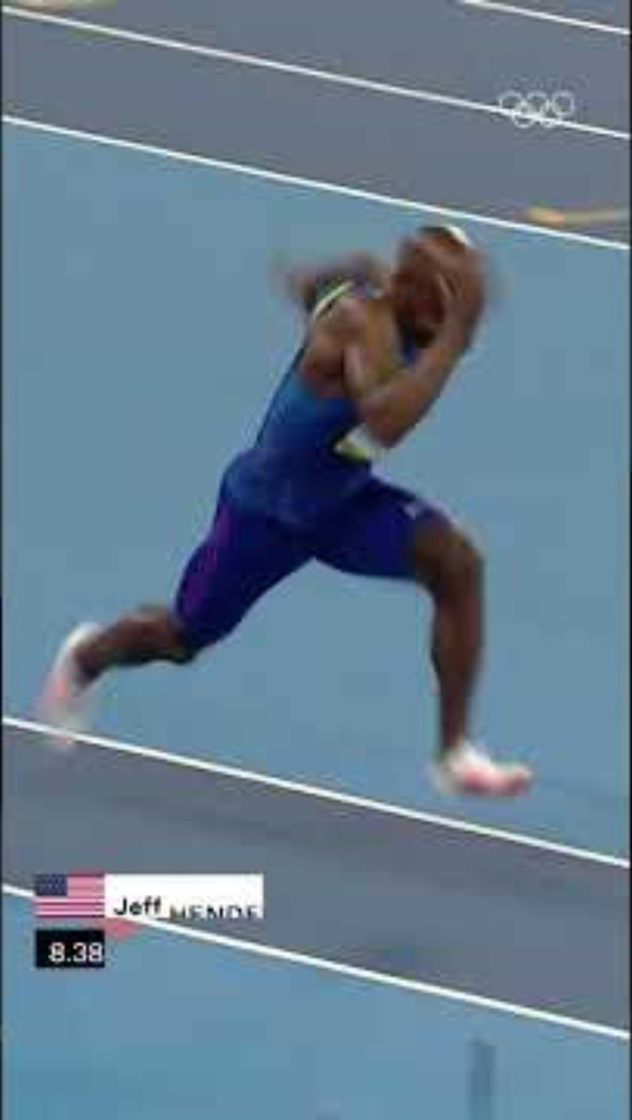
16 and 17 year-olds can have a lot of impact, and can gain lots of momentum.

Slide 16
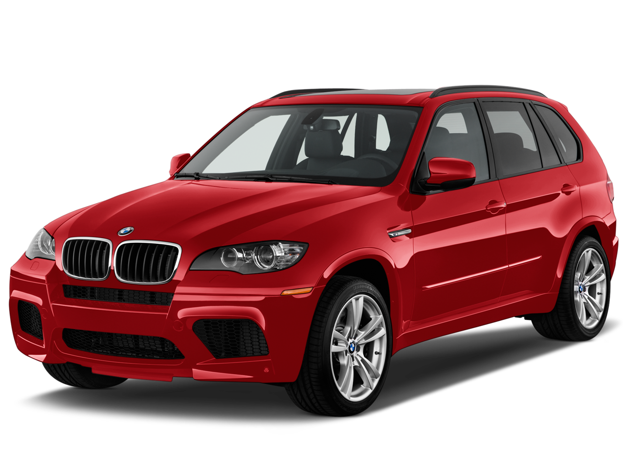
16 and 17:
Preregister to Vote!
Be in the cue (automatic at 18)
Increase awareness
Vote in higher percentages
Voting 1st time=Lifetime
This Photo by Unknown Author is licensed under CC BY-NC

Slide 17
16 and 17:
Volunteer!
Campaigns
Voter (pre) Registration Drives
In the community
At your school
Help run voter education programs
Students Voting Mock Election
NVRD in MN High Schools
Youth Day at the Capitol

Slide 18
16 and 17:
Get Paid!
Election Judge Trainees
A full day and two hours paid training
Out of school
Great on a resume/application
‘See how the sausage is made’
*Vast majority come back to do it again!

Slide 19
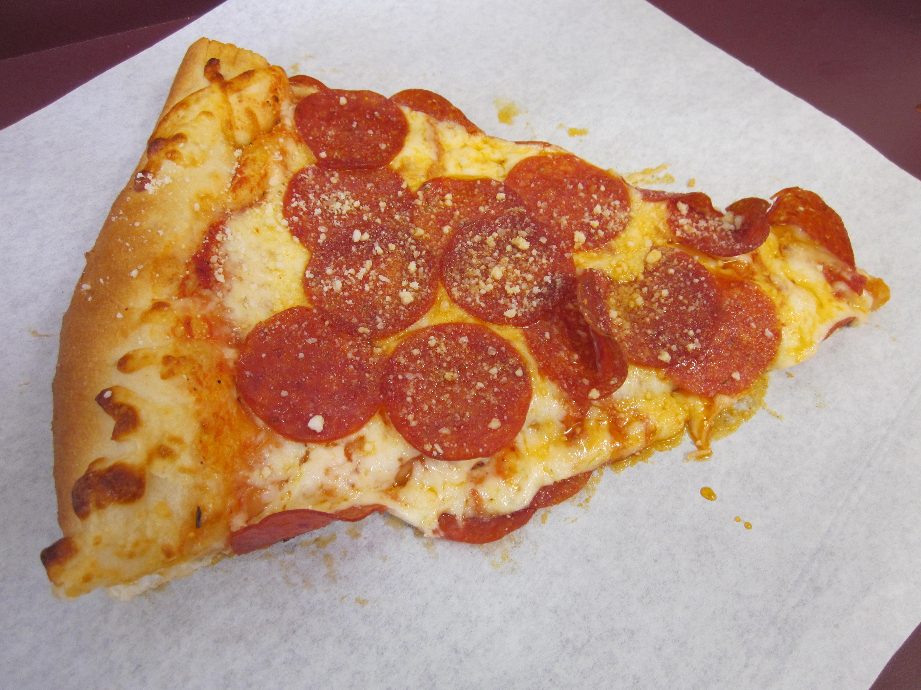
18 and Older:
Register to vote!
It’s required to vote
The Big Difference! (18-24 vs. 24+ in 2020)
Not percentage of registered who turn out…
Percentage of eligible who register! (86 v 92)
Decisions are made by those who show up
Reps listen to voters
This Photo by Unknown Author is licensed under CC BY-SA

Slide 20
18 and Older:
That other stuff!
Volunteering
Election Judge (WITH Party Declaration)

Slide 21
Everyone:

Slide 22
Learn the Process:
Study 1
Learning the how (mechanics) leads to much higher rates of voting the first time you become eligible

Slide 23
Learn the Process:
Study 2
Voting the first time you become eligible leads to much higher rates of lifelong voting.

Slide 24
Learn the Process:
KNOW:
Yourself (learn what you care about)
The Issues (What are laws controlling?)
What you think about the issues (see #1)
Who is running? (What’s on My Ballot)
Which candidates most closely match you

Slide 25
Learn the Process:
ADVOCATE:
Before and after they are elected, they need to hear from you. (Letters, Email, Phone Calls; Petitions; Visits…)
Who Represents Me?
Two Schools: Elect to follow you, or elect to do the best job they can

Slide 26
Learn the Process:
Registering/Pre-registering:
Long
Difficult
Hard to Understand

Slide 27
Learn the Process:
Registering/Pre-registering:
Long
Difficult
Hard to Understand
NOT AT ALL

Slide 28
Learn the Process:
(pre)Registering:
5 pages
All about you
Things you know

Slide 29
https://www.sos.state.mn.us/elections-voting/get-involved/the-online-pre-registrationstar-form-page-by-page/

Slide 30
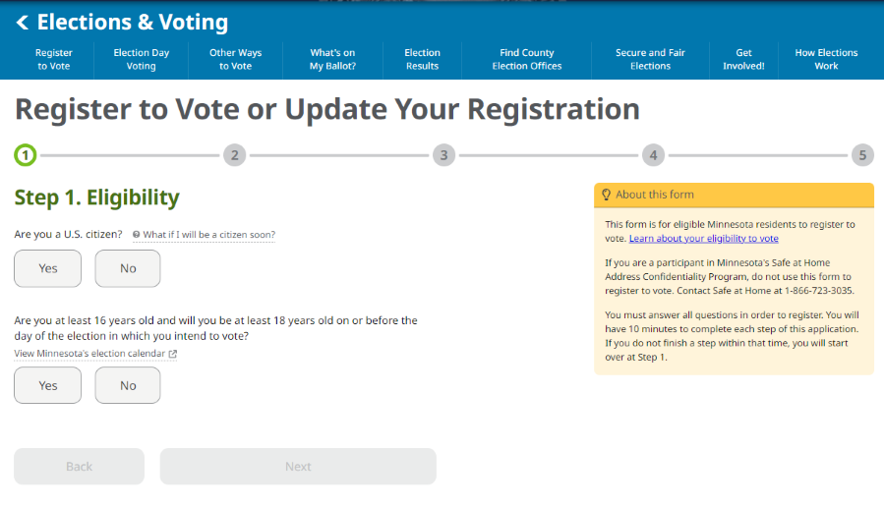

Slide 31
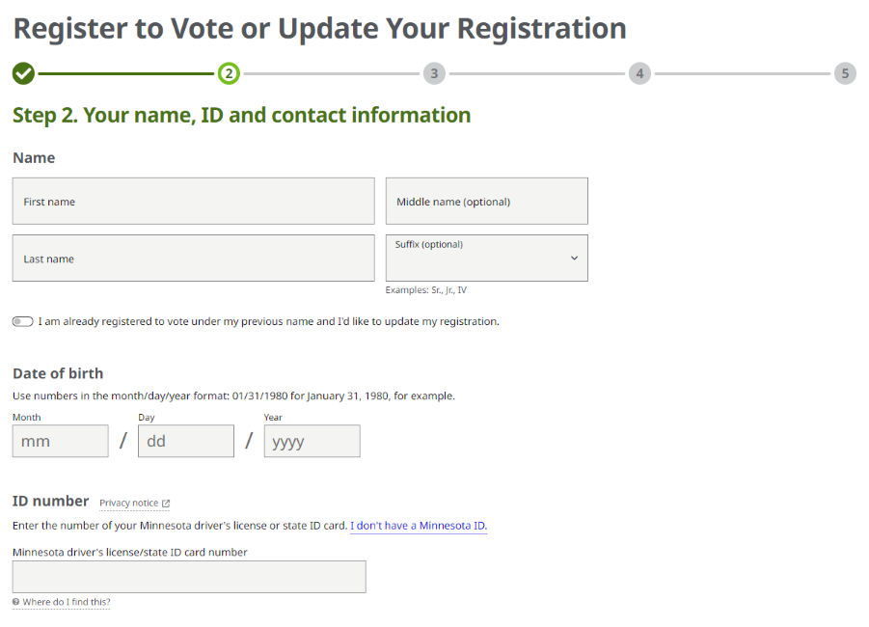

Slide 32
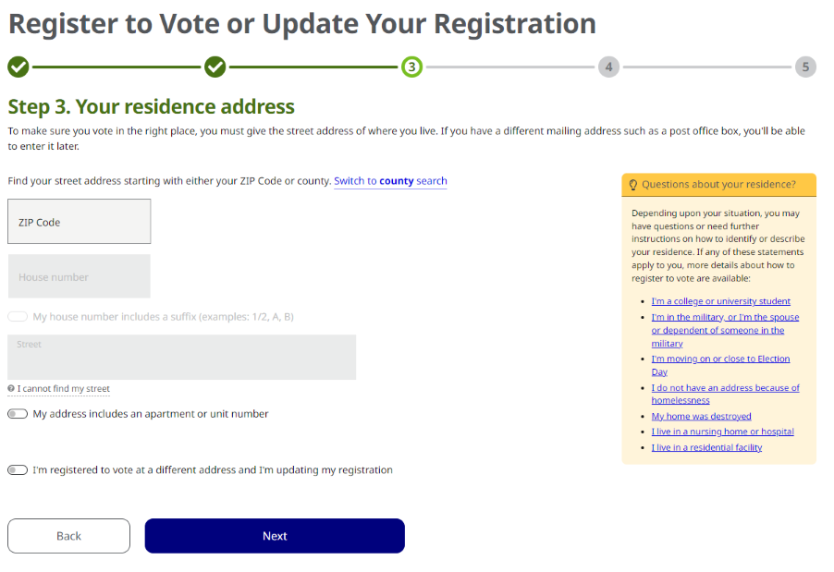

Slide 33
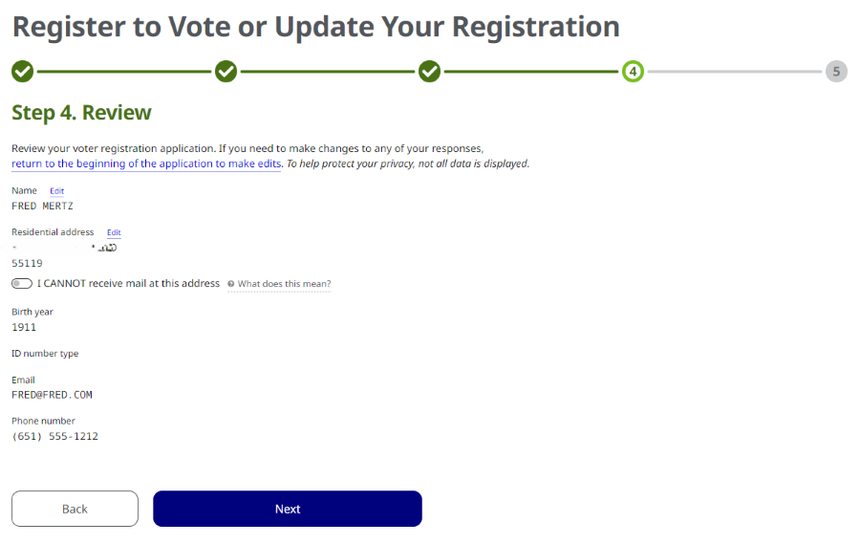

Slide 34
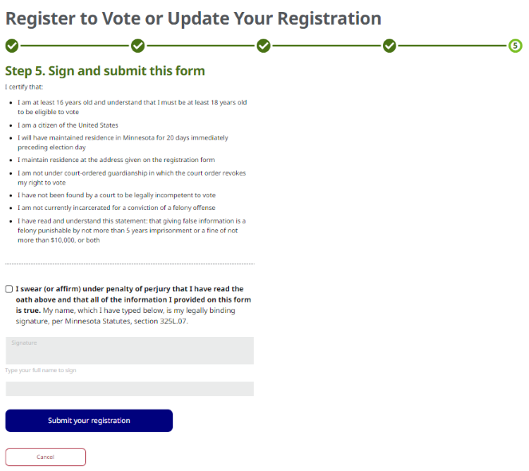

Slide 35
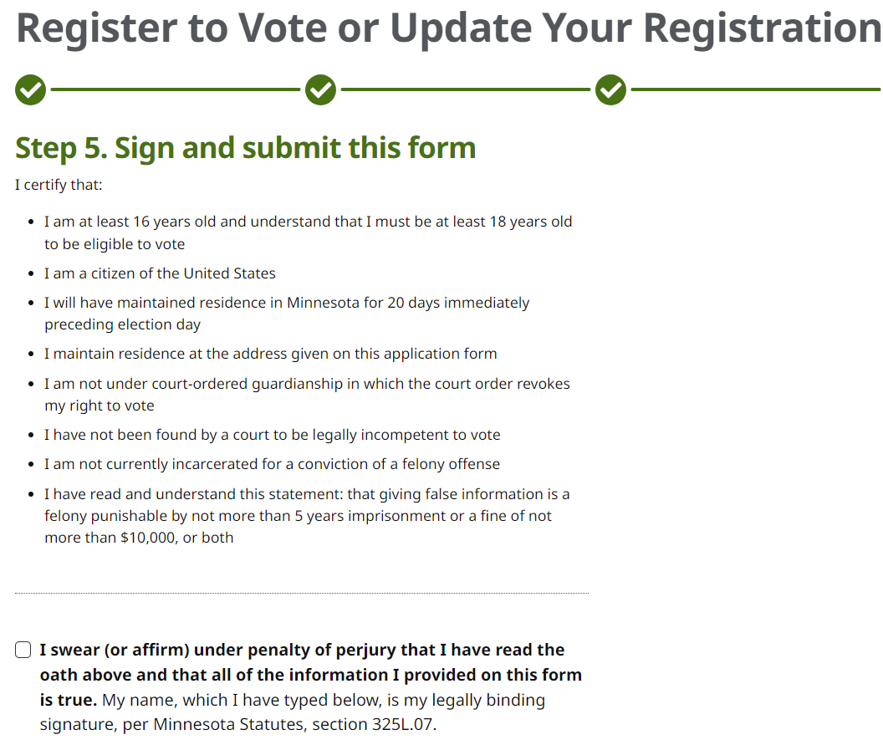

Slide 36
THAT’S IT!

Slide 37
How About the Ballot?

Slide 38
Ever taken a standardized test?

Slide 39
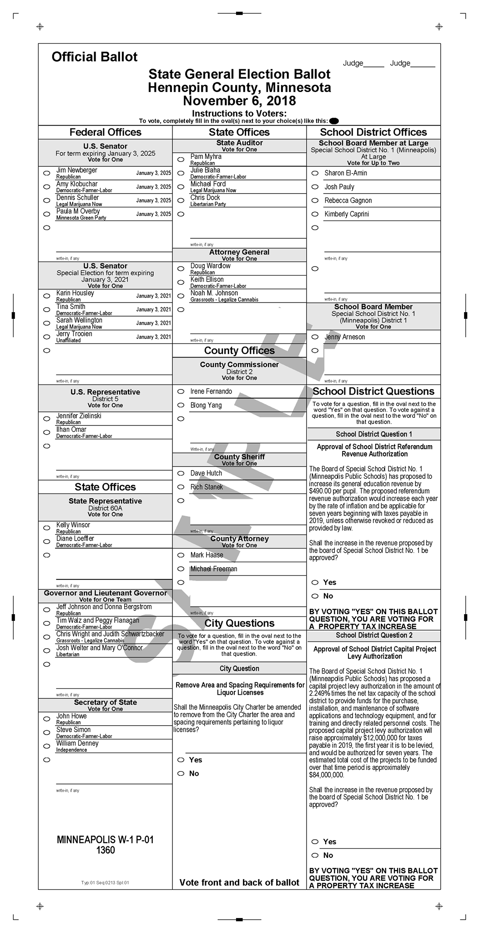

Slide 41
How About a Polling Place?

Slide 42
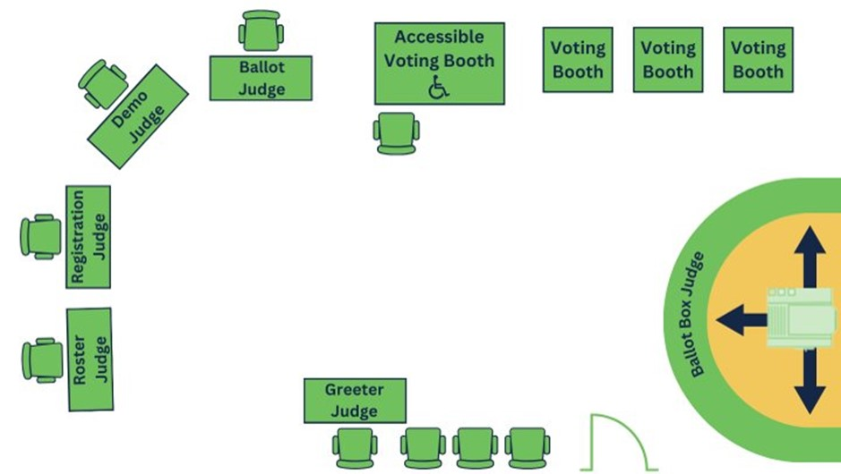

Slide 43
QUESTIONS?

Slide 44
www.sos.state.mn.us/elections-voting/get-involved
Michael Wall
Michael.Wall@state.mn.us
651-201-6892

