Slide 1
Students Voting 2024
Helping Your Students Make Their Voices Heard

Slide 2
Welcome!
October 18, 2024

Slide 3
-Ways to run your vote.
-Researching the Ballot;Prepare to Vote: our Ballot Ready Voter’s Guide.
-Lots and Lots of Resources!
-Questions

Slide 4
Ways to run your vote.
These are NOT the only ways!

Slide 5
Ways to run your vote.
1) “School Pictures” Style (Gym, Library, etc.)
-Single polling place; scheduled visits
-Roster: By grade, alpha order
-Election Judges
-Faculty/staff
-Students
-Community members, parents

Slide 6
Ways to run your vote.
2) “School Pictures” Style, Siloed (by grade, etc.)
-Multiple polling places; scheduled visits
-Roster: By grade, (advisory?),alpha order
-Election Judges
-Faculty/staff
-Students
-Community members, parents

Slide 7
Ways to run your vote.
3) Classroom Polling Places
-Simultaneous voting schoolwide
-Roster: copy of the class roster
-Election Judges
-Students

Slide 8
Ways to run your vote.
Counting ballots
-Always two people, each separately counting to verify
-By polling place
-Classrooms do their count and pass along to schoolwide count
-Central polling places- counting party

Slide 9
Ways to run your vote.
REPORTING
-To Students Voting:
-Link to form will be sent
-Just the Presidential race
-Entered candidate by candiate
-To the school
-Count what you ask students to vote
-TELL EVERYONE!

Slide 10
Ways to run your vote.
REPORTING
Seriously: It is crucial that you report the Presidential results so the program remains a strong resource, for you and over 525 schools statewide.
Thank You!

Slide 11
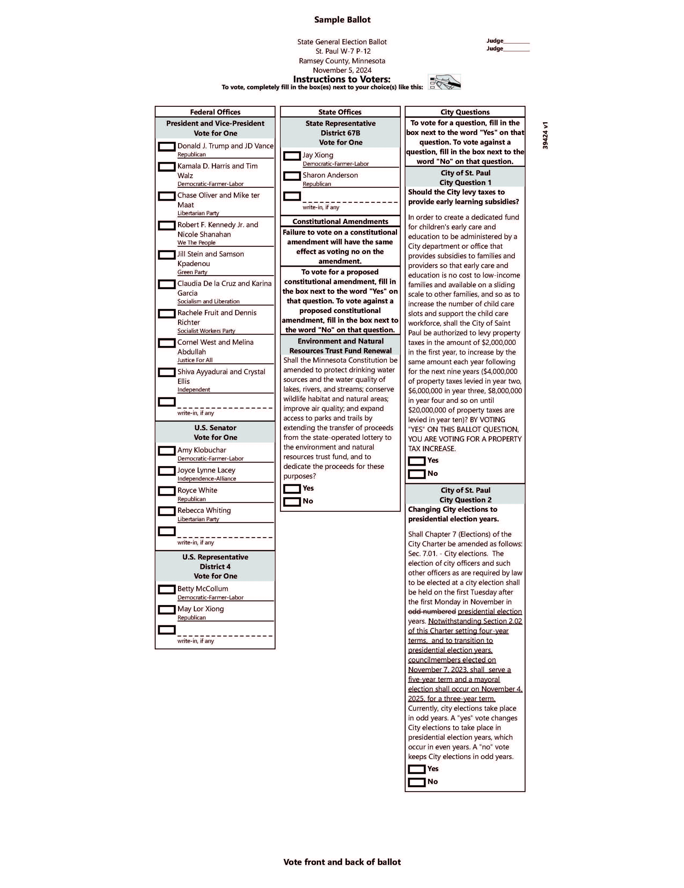
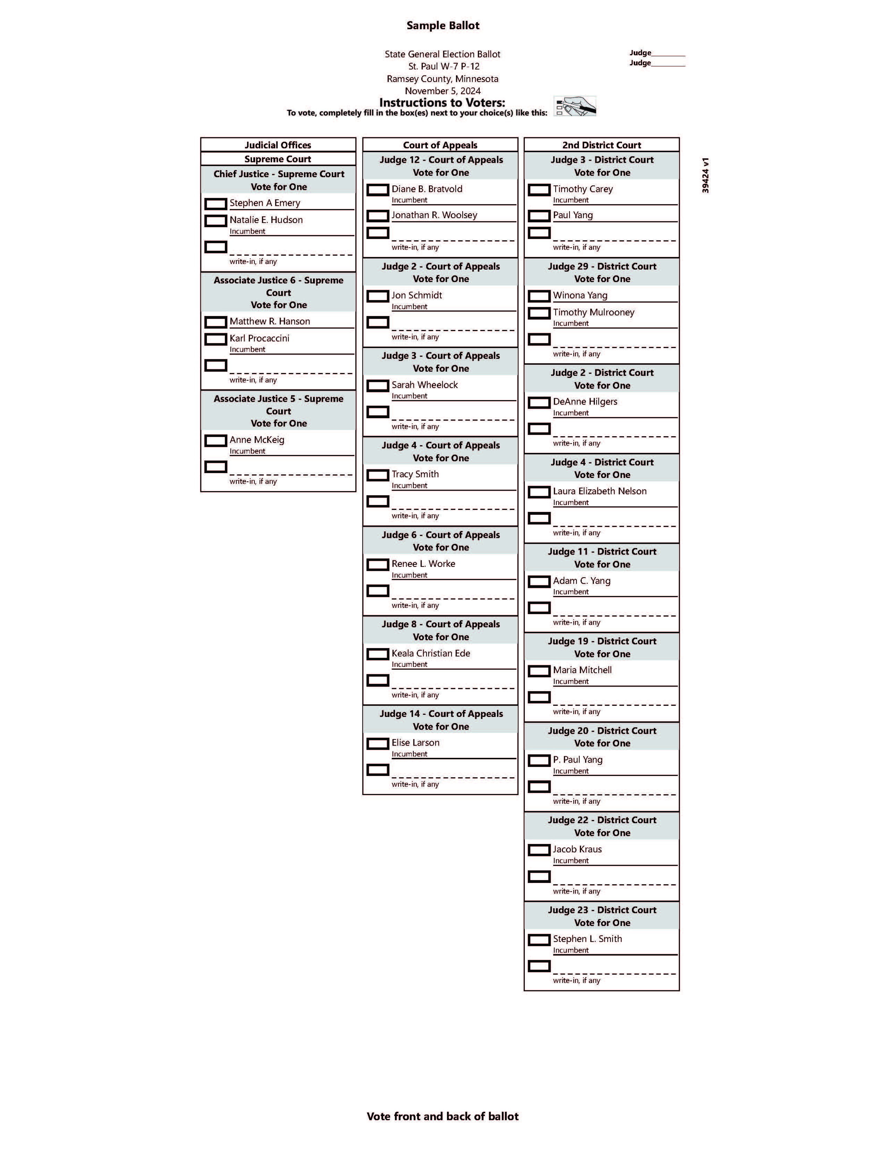
See, Explore, and Understand the Ballot

Slide 12
See, Explore, and Understand the Ballot
www.ymcanorth.org/locations/center_for_youth_voice/programs/students_voting/resources/ballot_ready
Share the LOOK of the ballot, and help them understand what is ON the ballot.

Slide 13
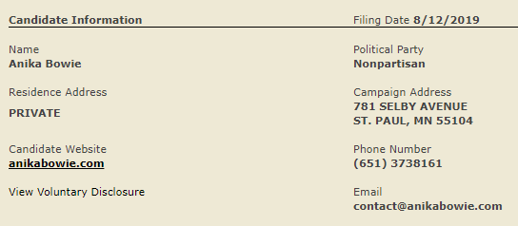
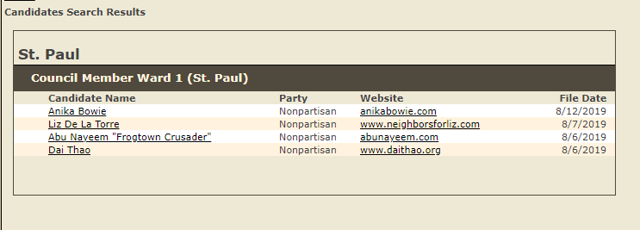
See, Explore, and Understand the Ballot
www.ymcanorth.org/locations/center_for_youth_voice/programs/students_voting/resources/ballot_ready
Help them understand what is ON the ballot.
-Get a Sample Ballot: https://myballotmn.sos.state.mn.us/ -Look at candidate web sites (if they have them)
https://candidates.sos.state.mn.us/

Slide 14
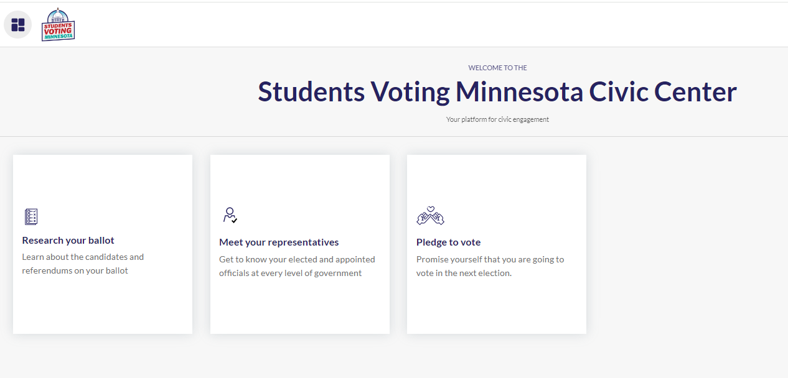
The Students Voting Ballot Ready Voter’s Guide

Slide 15
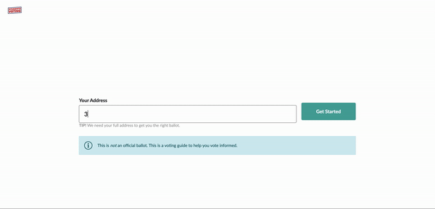
Step 1: Locating My Ballot
Students will enter their school address from a dropdown menu. www.ymcanorth.org/locations/center_for_youth_voice/programs/students_voting/resources/ballot_ready (Using a home address may not show the same ballot choices as their school ballot)

Slide 16
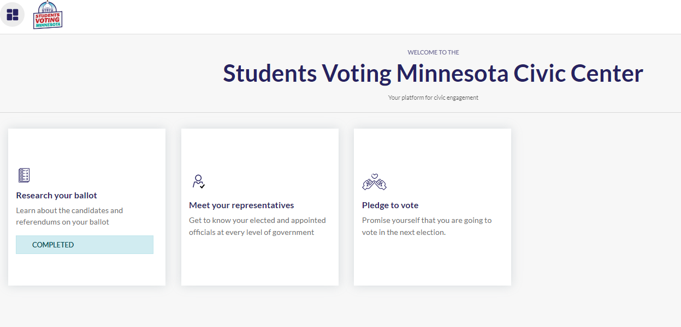
Step 1A: Current Office Holders and Positions
At any point, the student may click on “Meet Your Representatives.” This area includes the description of offices, who holds that position, and links to more information on the person.

Slide 17
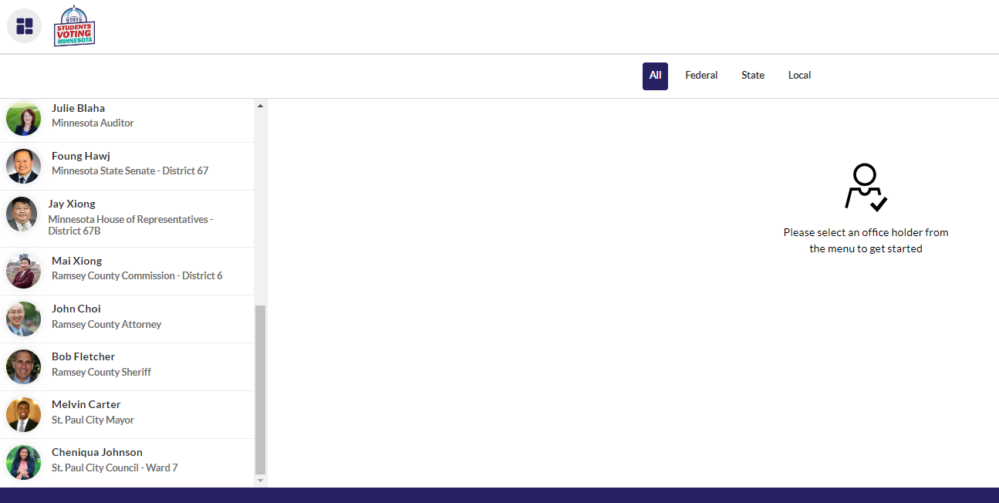
Step 1A: Current Office Holders and Positions

Slide 18
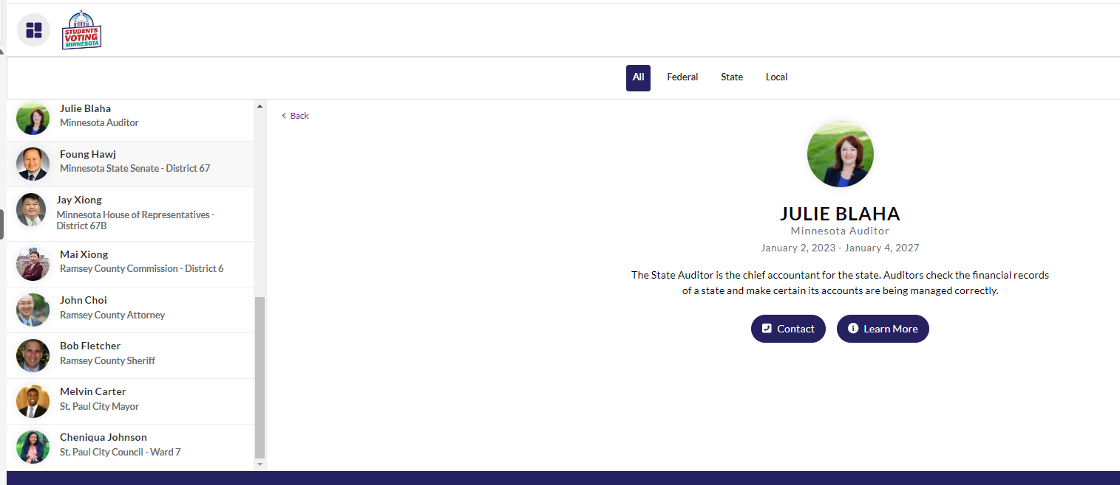
Step 1A: Current Office Holders and Positions

Slide 19
Step 1A: Current Office Holders and Positions

Slide 20
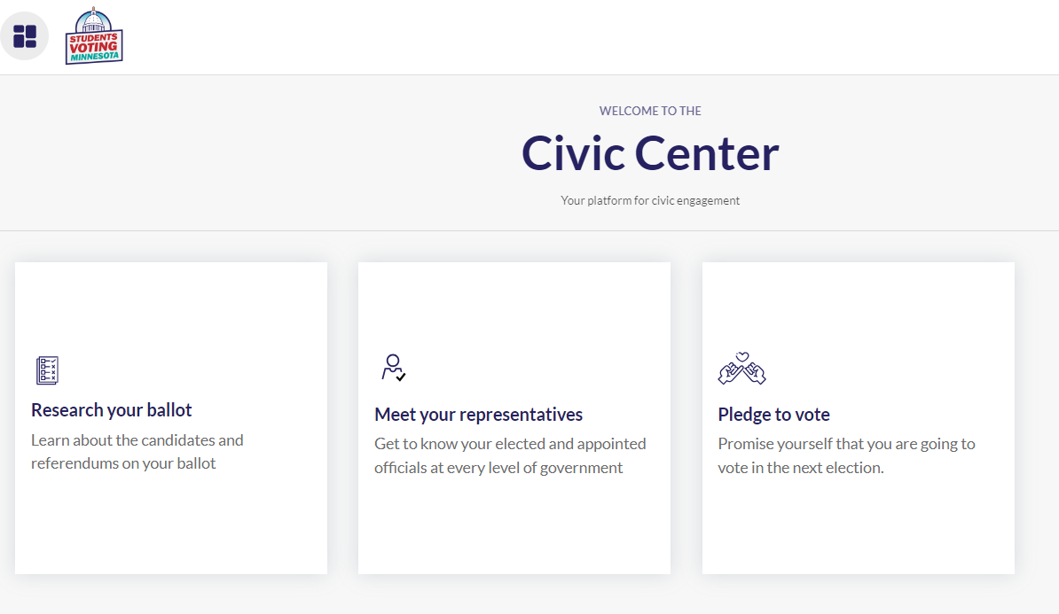
Step 2: Seeing My Ballot
Students will see a list three boxes. Click the left box to see the ballot.

Slide 21
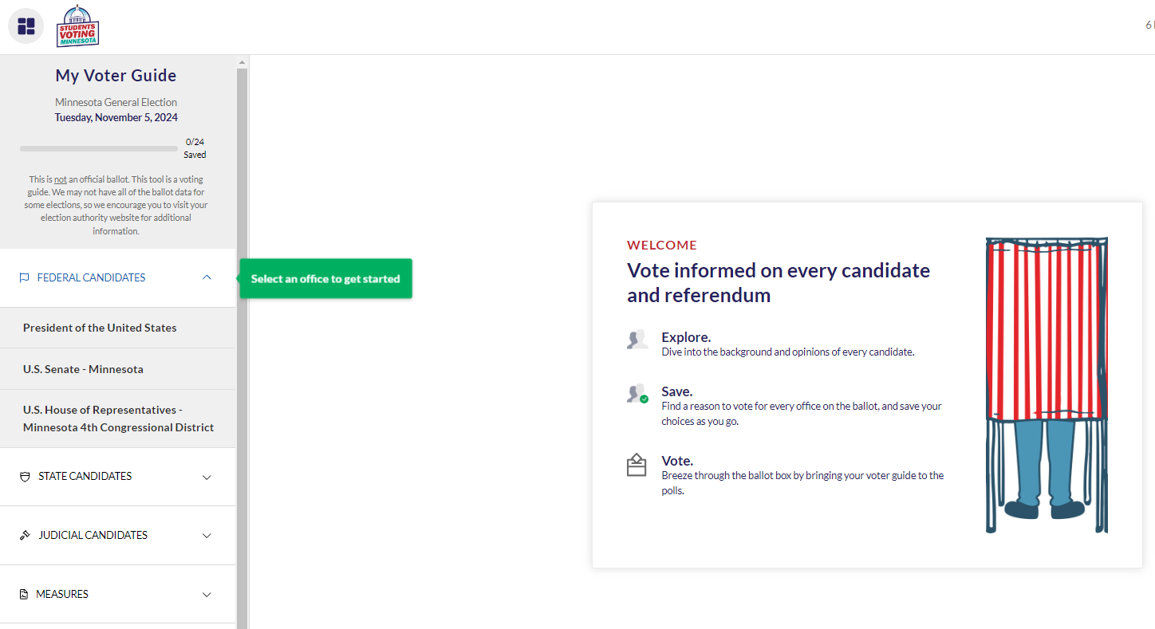
Step 3: Rearching My Ballot
Students will see a list of elected offices on their screen. They’ll click on an office, see the candidates in that race and read a short description of the office’s responsibilities.

Slide 22
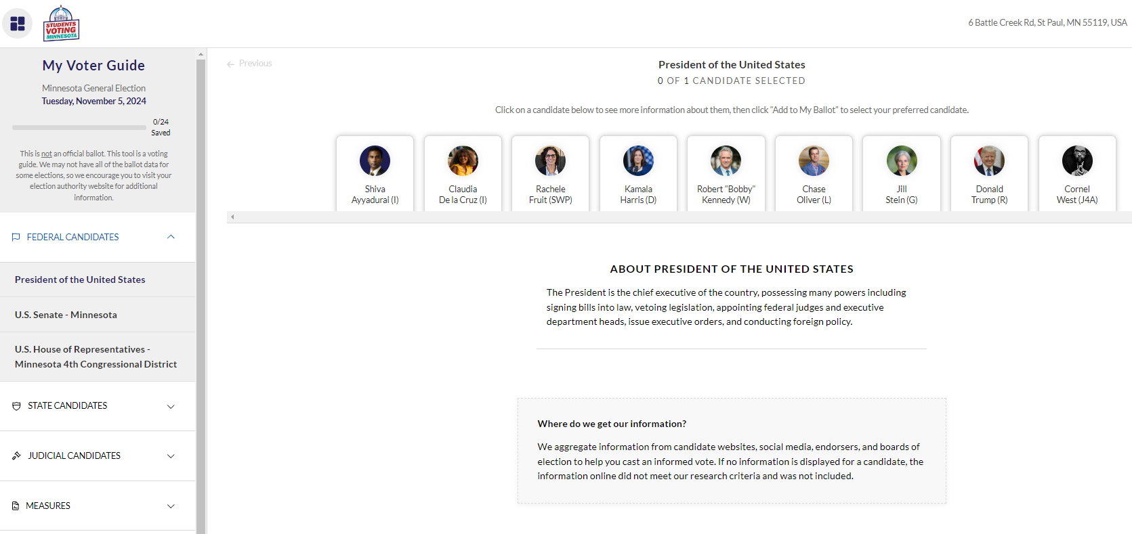
Step 3: Researching My Ballot

Slide 23
Step 3: Researching My Ballot

Slide 24
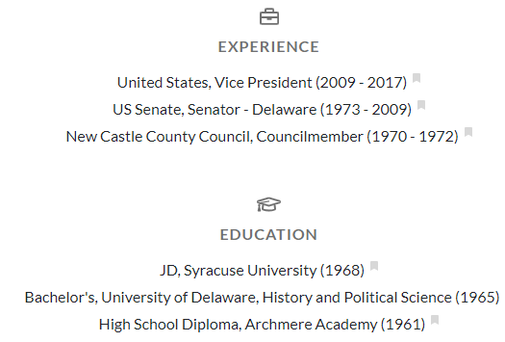
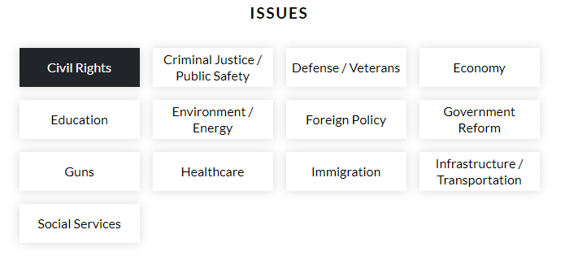
Step 4: Researching My Ballot
Once they click on a candidate, students will see each candidate’s education, experience, and their positions on different issues.

Slide 25
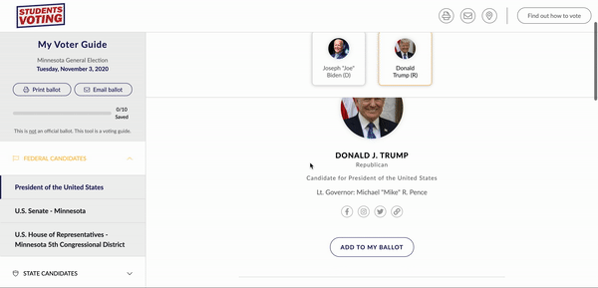
Step 3: Adding Candidates to My Ballot
For each office, the student chooses a candidate and clicks ‘Add To My Ballot.’ Then they move on to the next office.

Slide 26
Optional: Saving My Ballot For Later
Students can choose to save their ballot information by either creating a pdf or printing out a list of their selections. This way they don’t need to remember their choices if they need more than one session to vote.

Slide 27
Optional DISCUSSION: Making a Plan to Vote
Adults (voters) not only have to register and figure out the WHO of voting, they also have to plan the HOW of voting!
Will I vote in person or by mail?
Will I vote early or on Election Day?
Will I mail in my absentee ballot or drop it off?

Slide 28
Step 6: Casting My Ballot
Once students have completed their sample ballot,
they will be ready to cast their ballot at school!

Slide 29
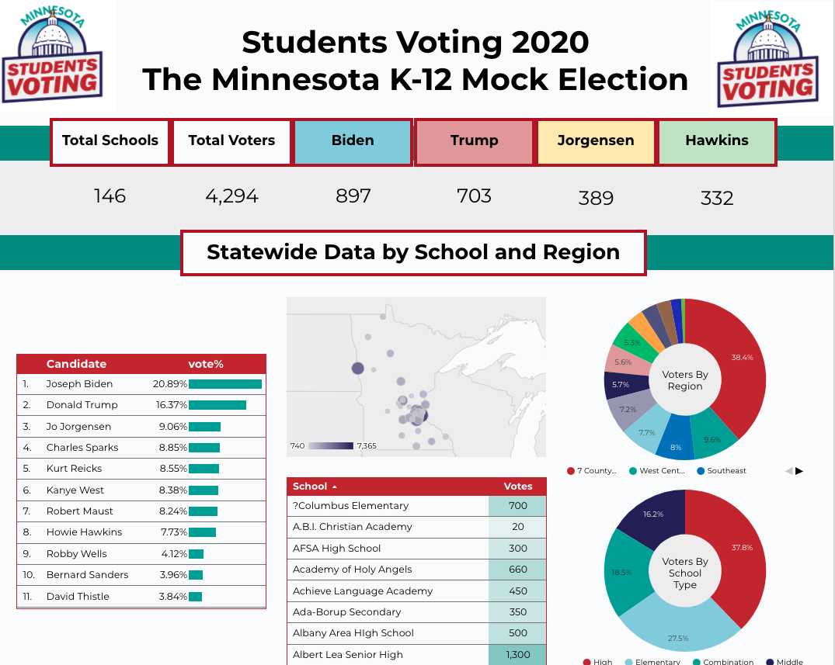
Dashboard
Our dashboard will include results from the mock election -- and a wealth of other information! -- and will be available to educators at all participating schools.
We will also provide materials to help you understand how you can use the dashboard to discuss and analyze the election results with your class.
Please note that these example images use randomly generated sample numbers.

Slide 30
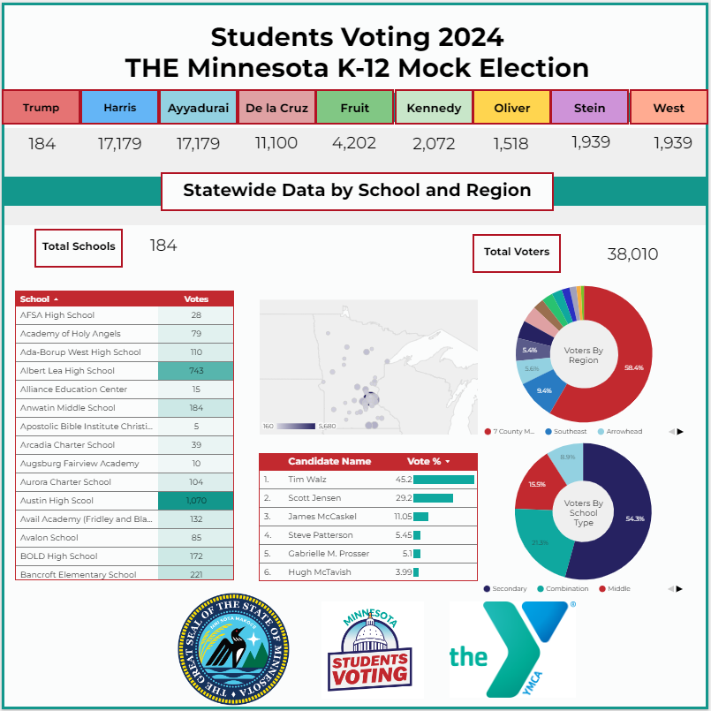
Please note that these example images use randomly generated sample numbers.

Slide 31
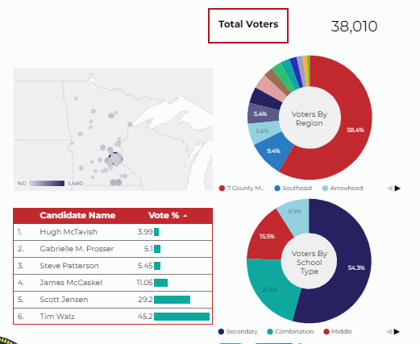
Please note that these example images use randomly generated sample numbers.

Slide 32
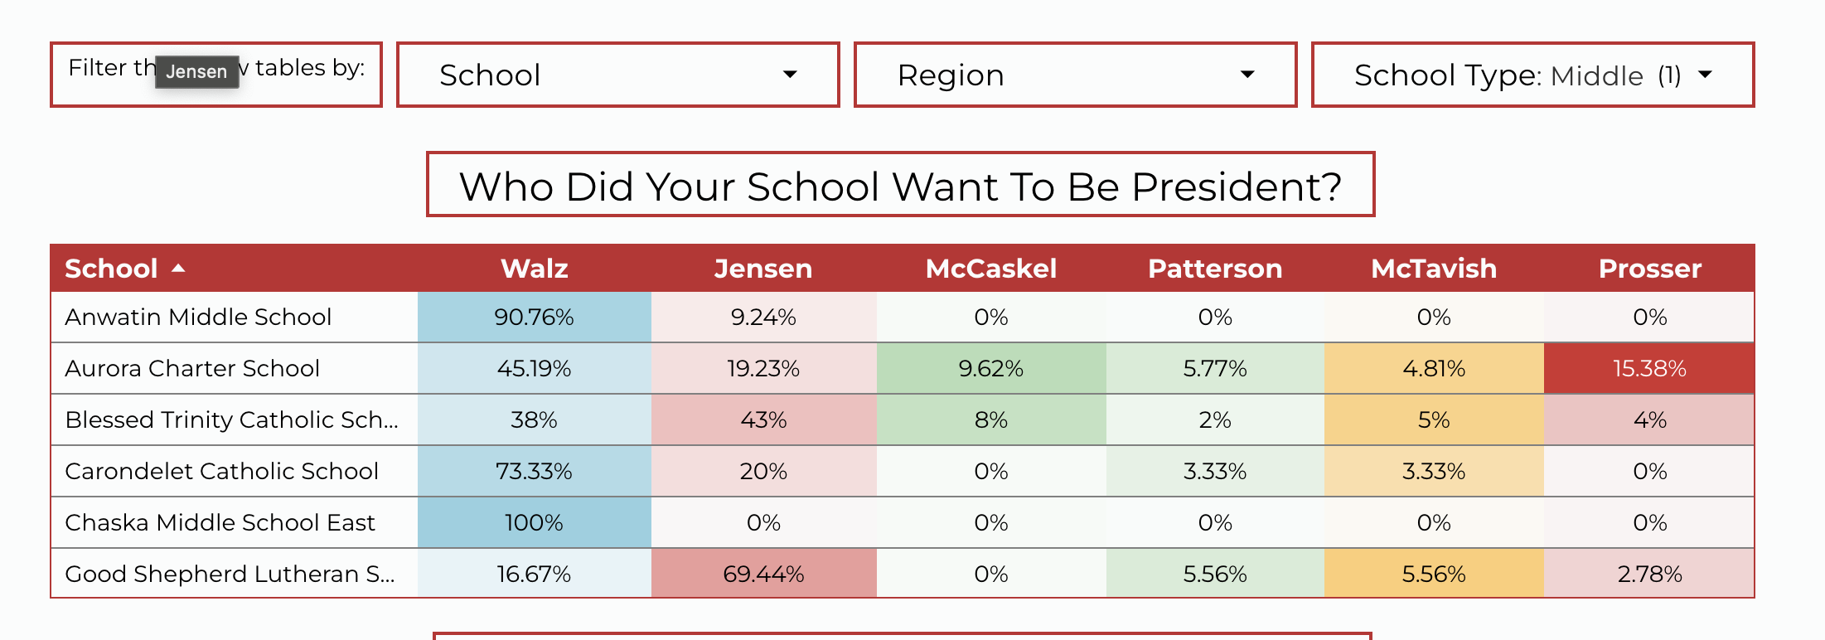
Dashboard
Please note that these example images use randomly generated sample numbers.

Slide 33
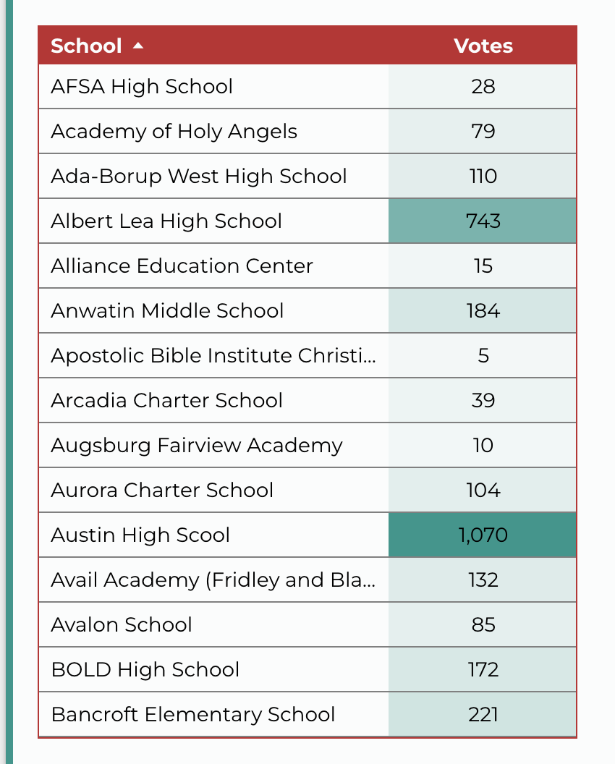
Dashboard
Please note that these example images use randomly generated sample numbers.

Slide 34
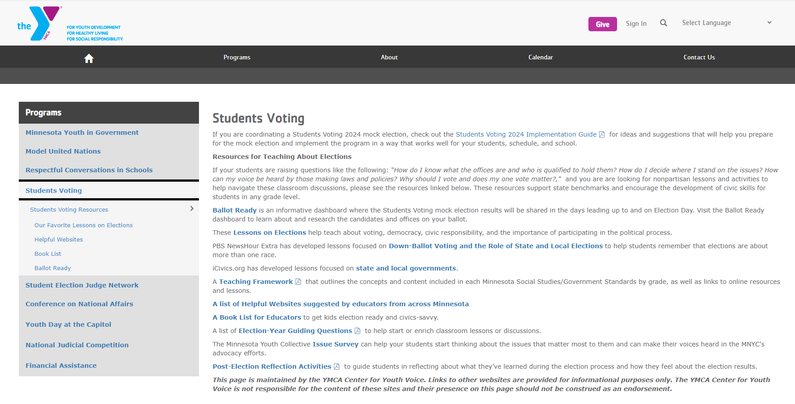
RESOURCES
www.ymcanorth.org/locations/center_for_youth_voice/programs/students_voting/

Slide 35
RESOURCES
www.ymcanorth.org/locations/center_for_youth_voice/programs/students_voting/

Slide 36
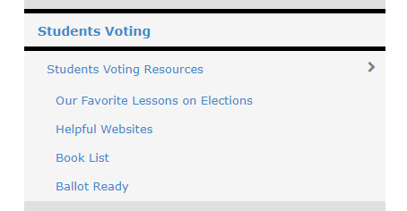
RESOURCES
www.ymcanorth.org/locations/center_for_youth_voice/programs/students_voting/

Slide 37
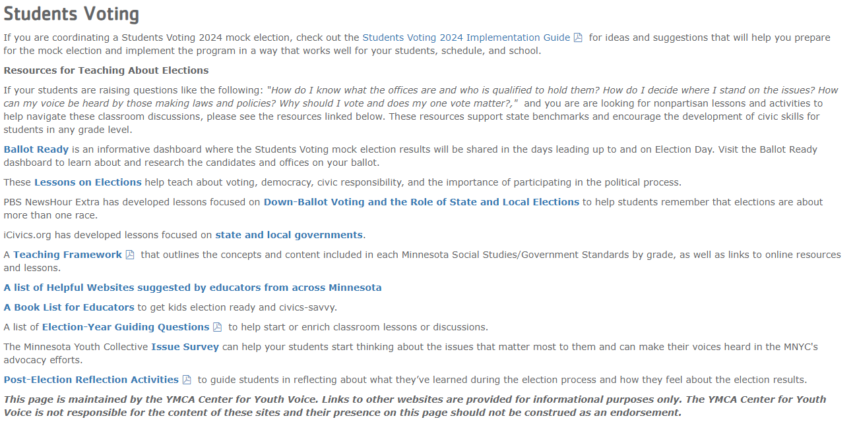
RESOURCES
www.ymcanorth.org/locations/center_for_youth_voice/programs/students_voting/

Slide 38
RESOURCES
www.ymcanorth.org/locations/center_for_youth_voice/programs/students_voting/

Slide 39
RESOURCES
www.ymcanorth.org/locations/center_for_youth_voice/programs/students_voting/

Slide 40
RESOURCES
www.ymcanorth.org/locations/center_for_youth_voice/programs/students_voting/

Slide 41
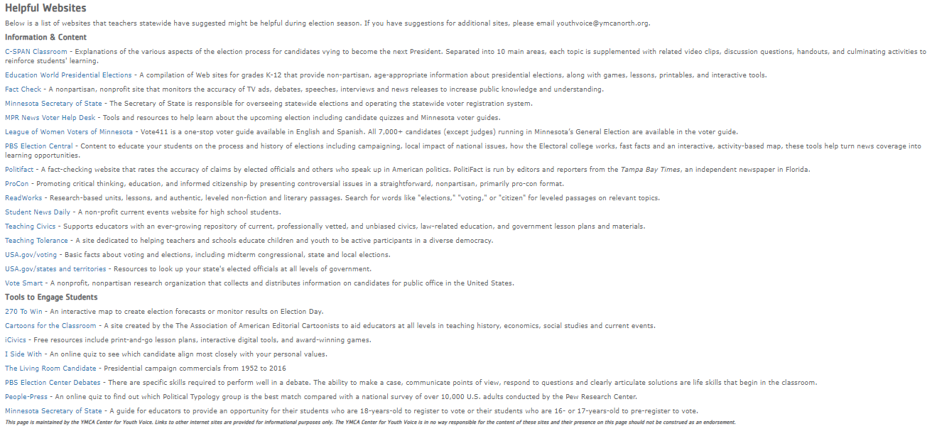
RESOURCES
www.ymcanorth.org/locations/center_for_youth_voice/programs/students_voting/

Slide 42
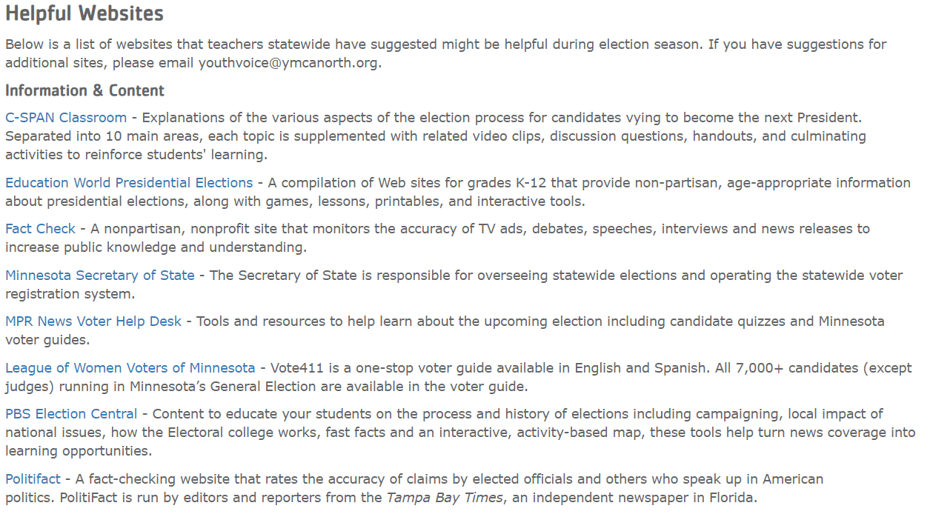
RESOURCES
www.ymcanorth.org/locations/center_for_youth_voice/programs/students_voting/

Slide 43
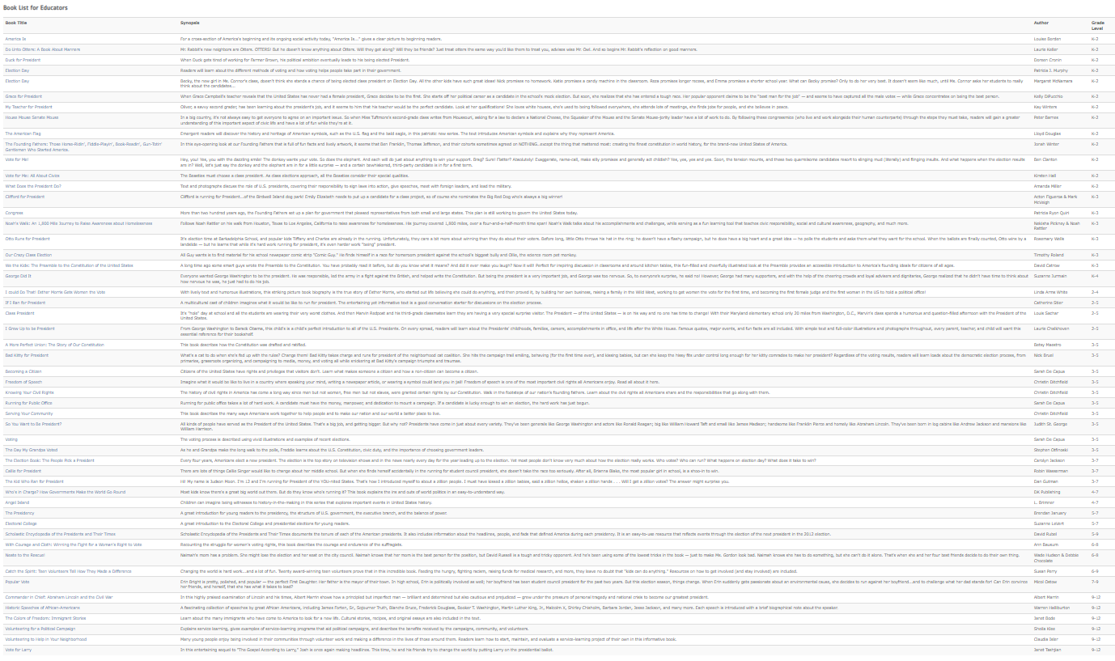
RESOURCES
www.ymcanorth.org/locations/center_for_youth_voice/programs/students_voting/

Slide 44
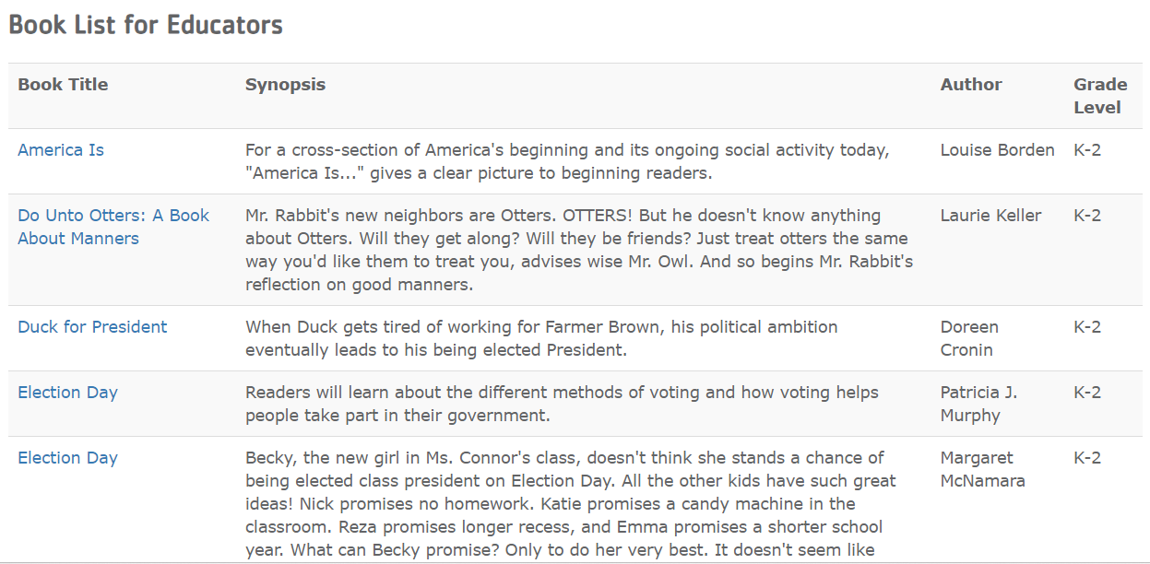
RESOURCES
www.ymcanorth.org/locations/center_for_youth_voice/programs/students_voting/

Slide 45
RESOURCES
www.ymcanorth.org/locations/center_for_youth_voice/programs/students_voting/

Slide 46
RESOURCES
www.ymcanorth.org/locations/center_for_youth_voice/programs/students_voting/

Slide 47
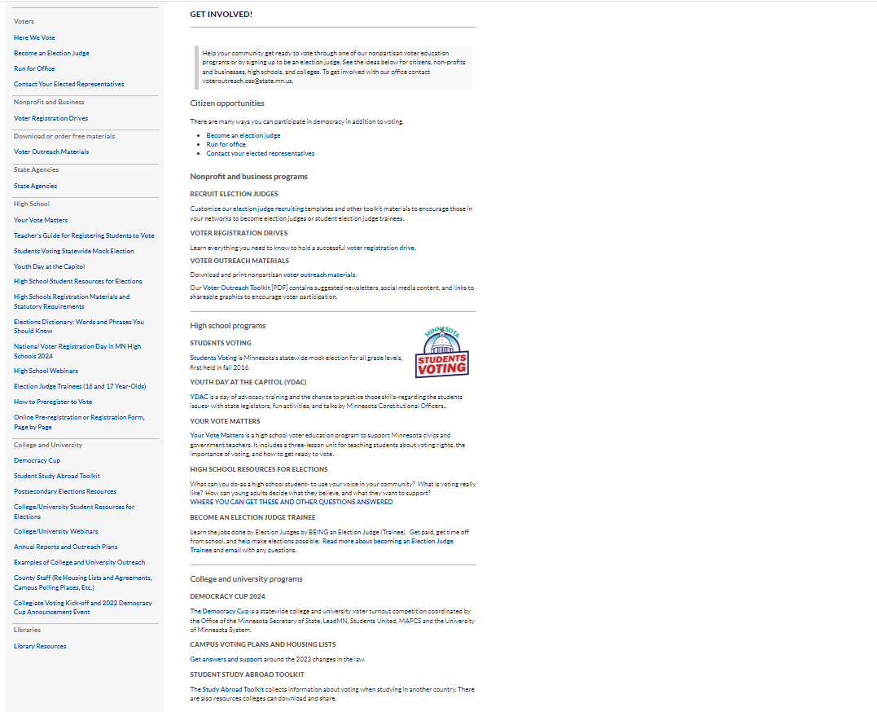
RESOURCES
www.sos.state.mn.us/elections-voting/get-involved/

Slide 48
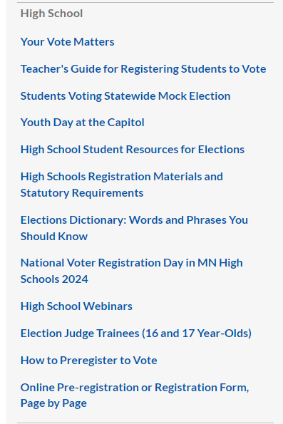
RESOURCES
www.sos.state.mn.us/elections-voting/get-involved/

Slide 49
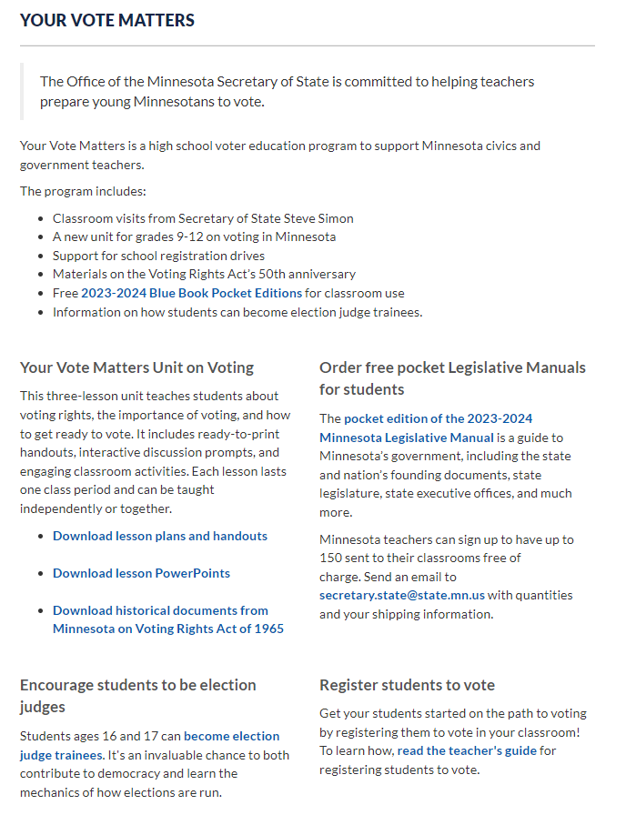
RESOURCES
www.sos.state.mn.us/elections-voting/get-involved/

Slide 50
RESOURCES
www.sos.state.mn.us/elections-voting/get-involved/

Slide 51
RESOURCES
www.sos.state.mn.us/elections-voting/get-involved/

Slide 52
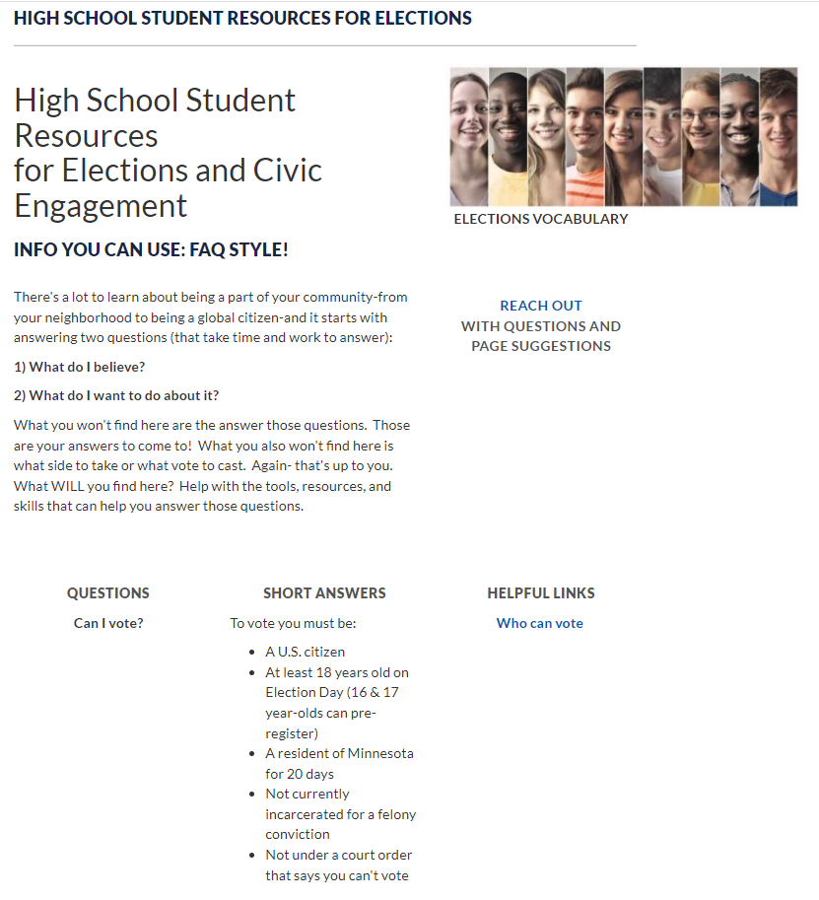
RESOURCES
www.sos.state.mn.us/elections-voting/get-involved/

Slide 53
RESOURCES
www.sos.state.mn.us/elections-voting/get-involved/
Work to be done
(Let us know terms)

Slide 54
RESOURCES
www.sos.state.mn.us/elections-voting/get-involved/

Slide 55
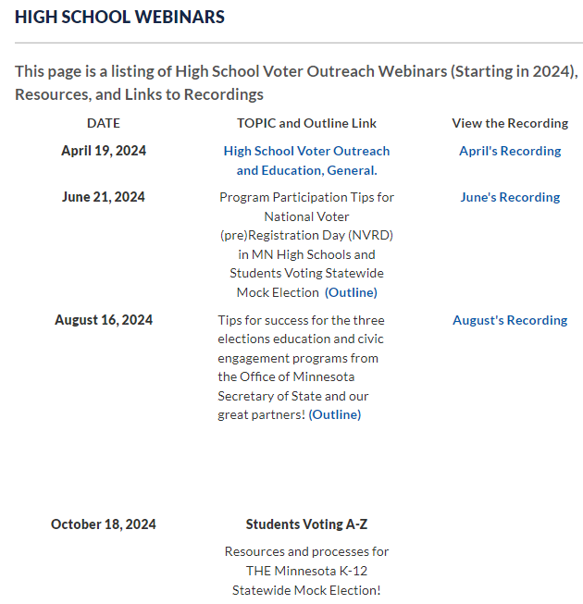
RESOURCES

Slide 56
RESOURCES
www.sos.state.mn.us/elections-voting/get-involved/

Slide 57
Questions?
Contacts:
Michael, michael.wall@state.mn.us
Brianne, brianne.leibham@ymcamn.org
Or go MNVotes.gov or YMCAnorth.org and search Students Voting

