Slide 2
Voting,
Advocacy,
and Civic Engagement
-------------

Slide 3
Civic Engagement is not a plated meal.
It’s a…

Slide 4
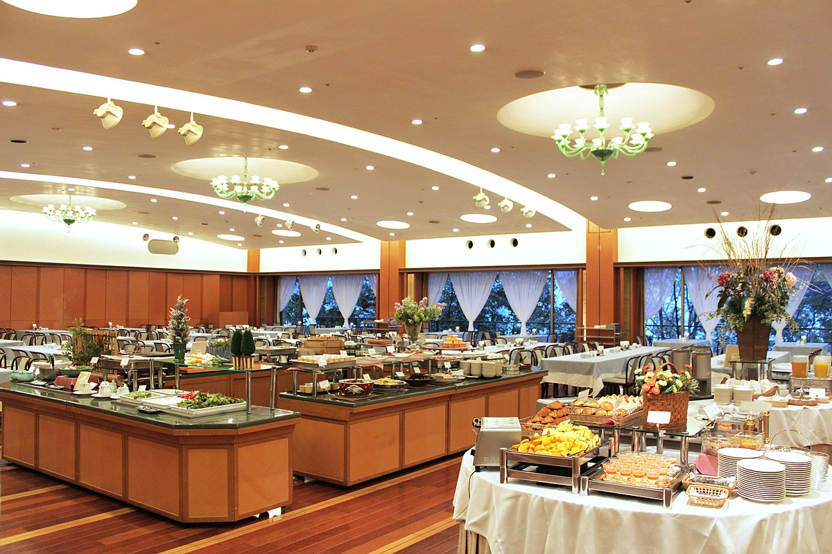
BUFFET
This Photo by Unknown Author is licensed under CC BY-SA

Slide 5
So…for high school civic engagement, what’s for dinner?

Slide 6
Let’s Break it Up:
16+17 vs. 18+
Type
Knowledge
Action
Effects

Slide 7
16 and 17 year-olds can have a lot of impact, and can gain lots of momentum.

Slide 8
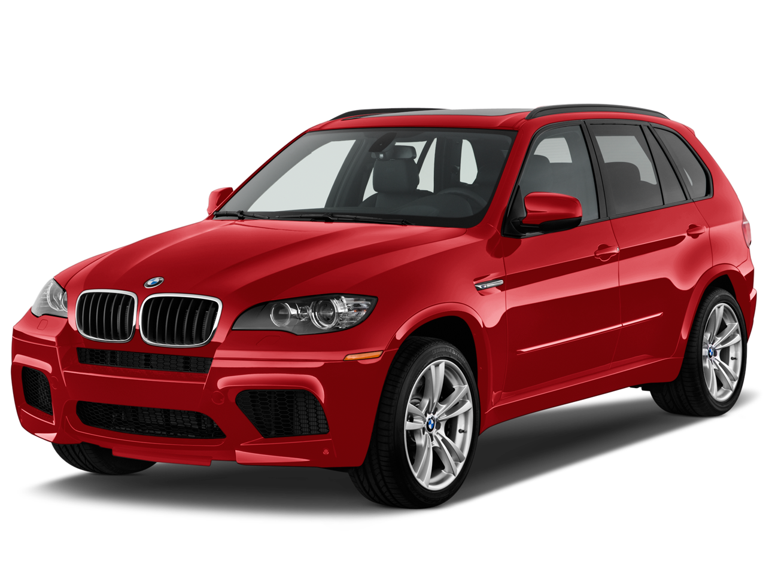
16 and 17:
Preregister to Vote!
Be in the cue (automatic at 18)
Increase awareness
This Photo by Unknown Author is licensed under CC BY-NC

Slide 9
16 and 17:
Volunteer!
Campaigns
Voter (pre) Registration Drives
In the community
At your school
Help run voter education programs
Students Voting Mock Election
National Voter Registration Day (NVRD) in MN High Schools
Youth Day at the Capitol

Slide 10
16 and 17:
Get Paid!
Election Judge Trainees
A full day and two hours paid training
Out of school
Great on a resume/application
‘See how the sausage is made’
*Vast majority come back to do it again!

Slide 11
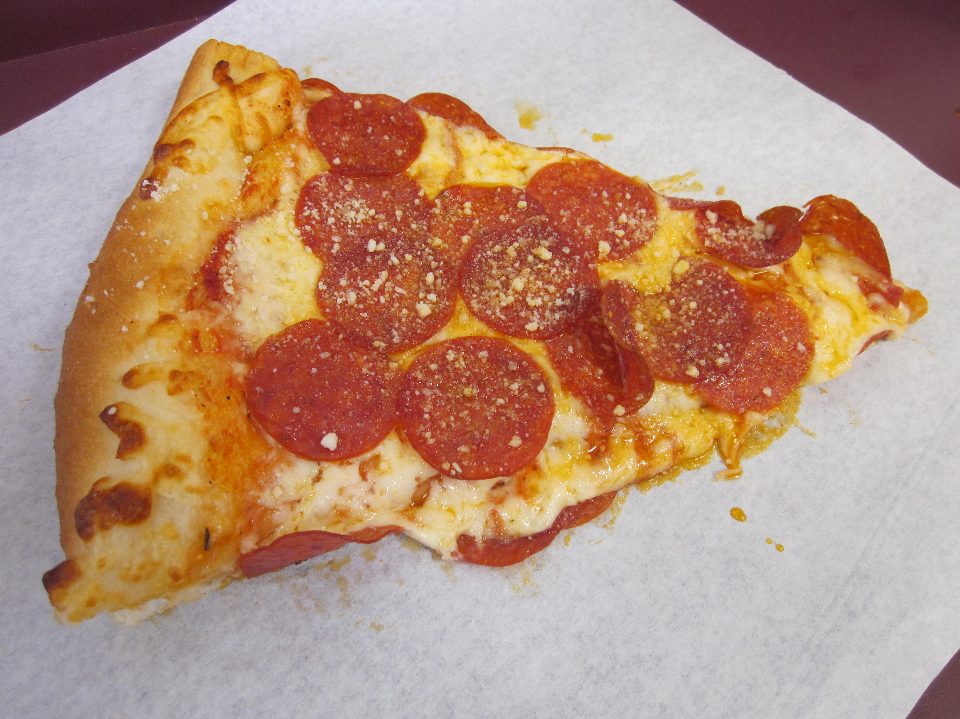
18 and Older:
Register to vote!
It’s required to vote
The Big Difference! (18-24 vs. 24+ in 2020)
Not percentage of registered who turn out…
Percentage of eligible who register! (86 v 92)
Decisions are made by those who show up
Reps listen to voters
This Photo by Unknown Author is licensed under CC BY-SA

Slide 12
18 and Older:
That other stuff!
Volunteering
Election Judge (WITH Party Declaration)

Slide 13
Learn the Process:
WHY?
Young people report they don’t vote for two main reasons:
No one asked them
They didn’t want to look stupid

Slide 14
Learn the Process:
Study 1
Learning the how (mechanics) leads to much higher rates of voting the first time you become eligible

Slide 15
Learn the Process:
Study 2
Voting the first time you become eligible leads to much higher rates of lifelong voting.

Slide 16
Learn the Process:
KNOW:
Yourself (learn what you care about)
The Issues (What are laws controlling?)
What you think about the issues
Who is running? (What’s on My Ballot)
Which candidates most closely match you

Slide 17
WHETHER YOU BELIEVE
“Trust but verify” or “Why would someone lie?” or “I don’t believe a word that comes out of their mouths”…
FACTS AND EVIDENCE ARE YOUR FRIENDS

Slide 19
Learn the Process:
ADVOCATE:
Once they are elected, they need to hear from you. (Letters, Email, Phone Calls; Petitions; Visits…)
Who Represents Me?
Two Schools: Elect to follow you, or elect to do the best job they can

Slide 20
Learn the Process:
(pre)Registering:
Long
Difficult
Hard to Understand

Slide 21
Learn the Process:
(pre)Registering:
Long
Difficult
Hard to Understand
NOT AT ALL

Slide 22
Learn the Process:
(pre)Registering:
5 pages
All about you
Things you know

Slide 23
https://www.sos.state.mn.us/elections-voting/get-involved/the-online-pre-registrationstar-form-page-by-page/

Slide 24
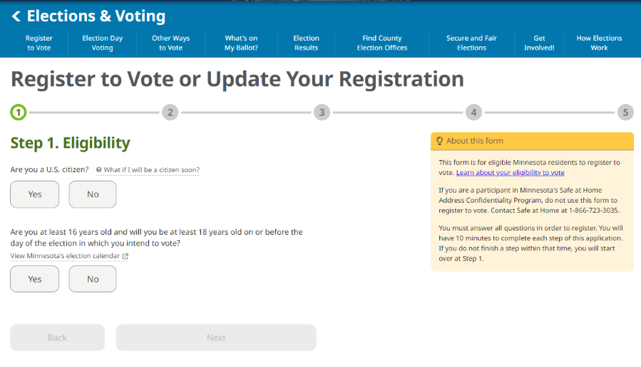

Slide 25
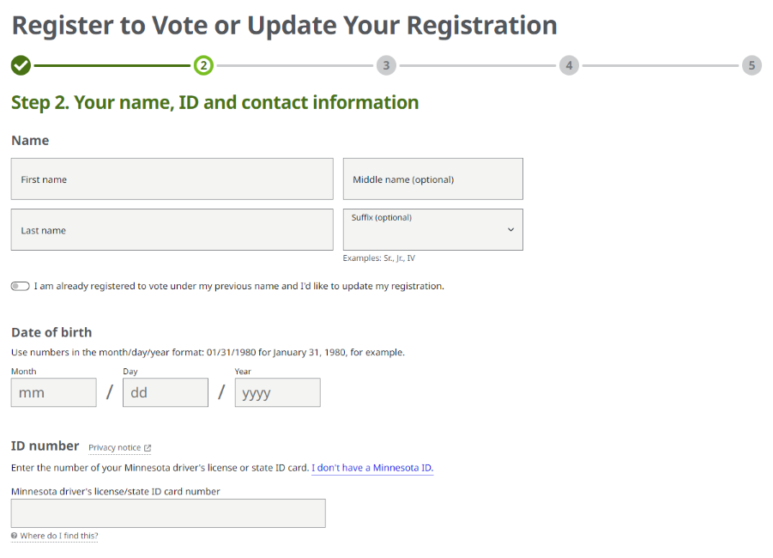

Slide 26
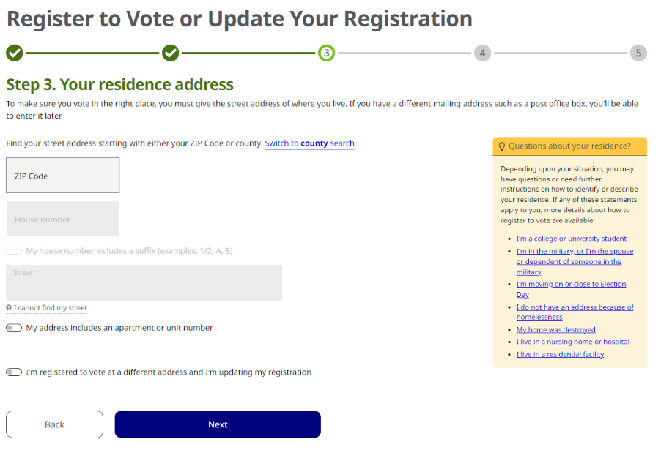

Slide 27
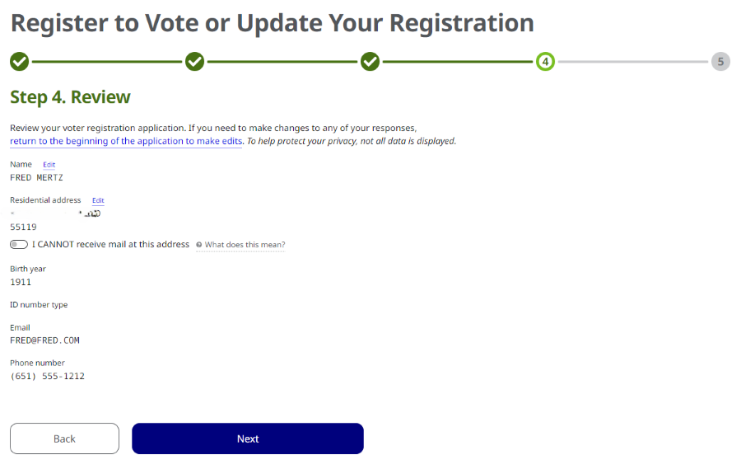

Slide 28
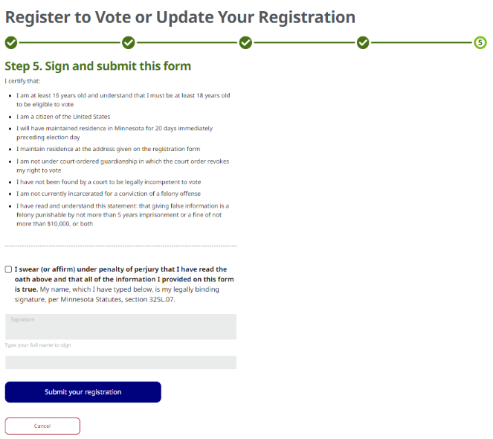

Slide 29
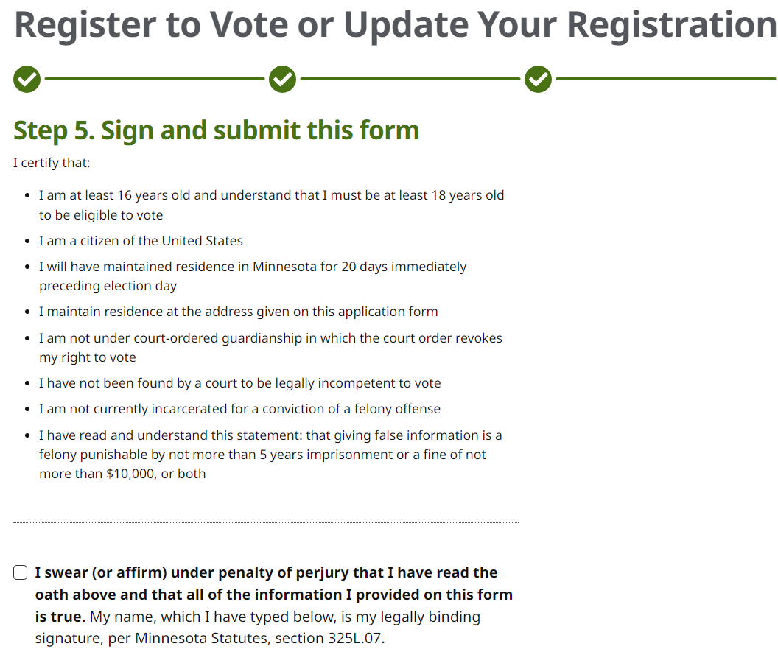

Slide 30
THAT’S IT!

Slide 31
How About the Ballot?

Slide 32
Ever taken a standardized test?

Slide 33
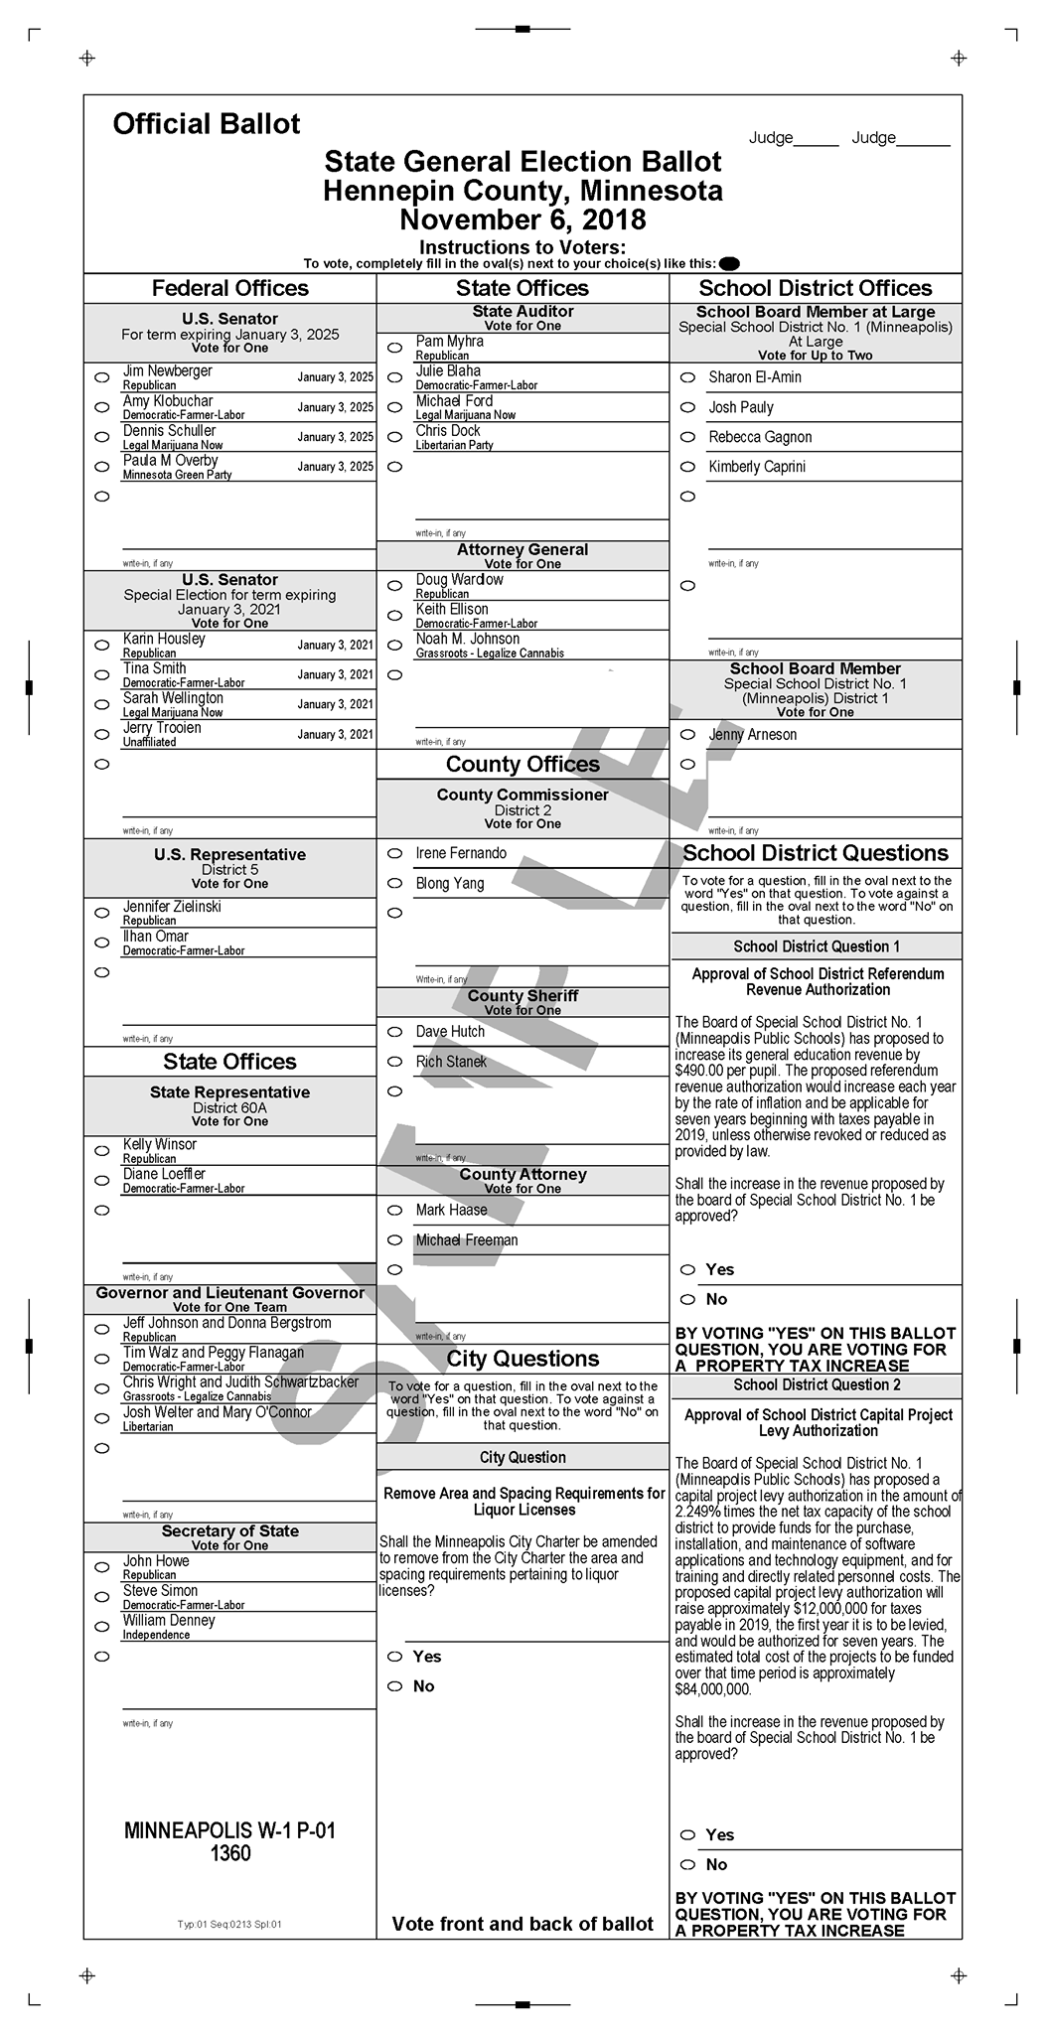

Slide 35
How About a Polling Place?

Slide 36
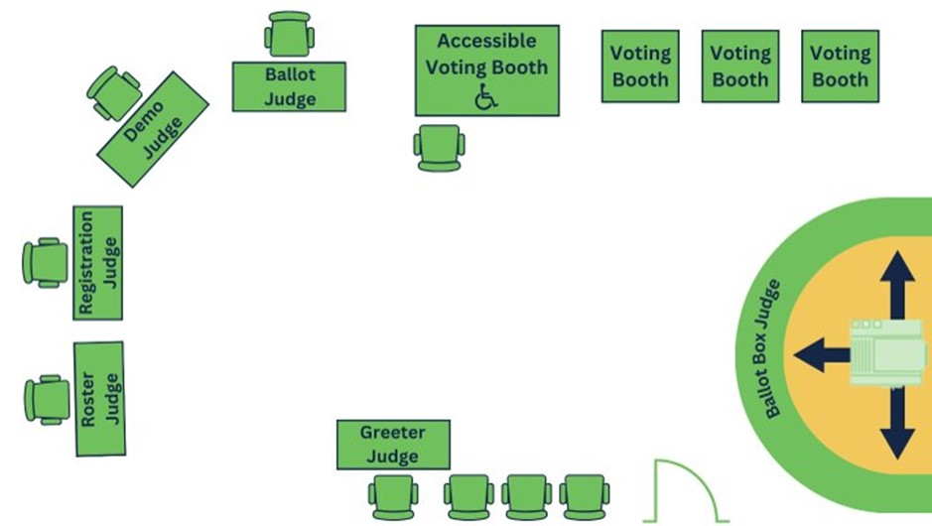

Slide 37
www.sos.state.mn.us/elections-voting/get-involved
Michael Wall
Michael.Wall@state.mn.us
651-201-6892

Slide 38
QUESTIONS?

