Slide 2
Elections and Voter Outreach Laws for Postsecondary Institutions
and High Schools
-------------

Slide 3
HIGH SCHOOLS

Slide 4
HIGH SCHOOLS
MN 201.1611 POSTSECONDARY INSTITUTION AND SCHOOL DISTRICT VOTER REGISTRATION.
§
Subdivision 1.Forms. Sections(b) and (c)

Slide 5
All school districts must make available voter registration applications each May and September to all students registered as students of the school district who will be eligible to vote at the next election after those months.
A school district has no obligation to provide voter registration applications to students who participate in a postsecondary education option program or who otherwise maintain residence in the district but do not attend a school operated by the district. A school district fulfills its obligation to a student under this section if it provides a voter registration application to the student one time.
The institutions and school districts may request these forms from the secretary of state.
School districts must advise students that completion of the voter registration application is not a school district requirement.

Slide 6
All school districts must make available voter registration applications each May and September to all students registered as students of the school district who will be eligible to vote at the next election after those months.
AS OF THIS JULY 1: b) All school districts must make available paper or electronic voter registration applications each May and September to all students registered as students of the school district who will be are eligible to
register or preregister to vote. at the next election after those months
A school district has no obligation to provide voter registration applications to students who participate in a postsecondary education option program or who otherwise maintain residence in the district but do not attend a school operated by the district. A school district fulfills its obligation to a student under this section if it provides a voter registration application to the student one time.
The institutions and school districts may request these forms from the secretary of state.
School districts must advise students that completion of the voter registration application is not a school district requirement.

Slide 7
All school districts must make available voter registration applications each May and September to all students registered as students of the school district who will be eligible to vote at the next election after those months.
A school district has no obligation to provide voter registration applications to students who participate in a postsecondary education option program or who otherwise maintain residence in the district but do not attend a school operated by the district. A school district fulfills its obligation to a student under this section if it provides a voter registration application to the student one time.
The institutions and school districts may request these forms from the secretary of state. (It’s 2024! Paper Forms?)
School districts must advise students that completion of the voter registration application is not a school district requirement.

Slide 8
COLLEGES

Slide 9
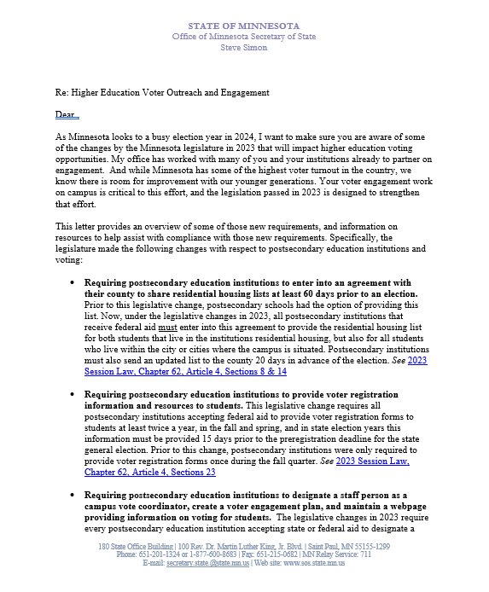
Letter From Secretary Simon Sent Fall 2023

Slide 10
1 2 3 4 5 6 7
Elections Items That Minnesota Law Says Colleges and Universities Must Do

Slide 11
1 2 3 4 5 6 7
Please.

Slide 12
1 2 3 4 5 6 7 8
Written agreement to County Auditor
To provide student housing lists for each election
By 60 days before the first election of the year.
Lasts for the calendar year

Slide 13
1 2 3 4 5 6 7 8
Prepare current list of enrolled students
Living in campus housing
Living in the campus city/cities (state aid)
-MAY include up to 10 miles from campus (federal aid)
Certified (signed off as current and accurate)
To Auditor each election (not before 20 days prior)

Slide 14
1 2 3 4 5 6 7 8
Provide registration forms to each student
Spring of each year
Fall of each year
Even years: delivered at least 36 days before the state general (November) election.
If form is provided electronically, email or text must be exclusively about voter registration.

Slide 15
1 2 3 4 5 6 7 8
Consult with campus student government
Most effective means of:
Distributing forms
Facilitating election day registration of students
To create voter engagement plan/report (#7)

Slide 16
1 2 3 4 5 6 7 8
Web page of voter/elections information
Voter registration and voting requirements
Deadlines
Residency requirements/methods to prove
Voting options
Resources for students registered in other states
Campus vote coordinator name/contact (see #6)
Voter engagement plan/report (see #7)

Slide 17
1 2 3 4 5 6 7 8
Designate staff Campus Vote Coordinator
Ensure institution complies requirements
Consult with campus student government (see #4)

Slide 18
1 2 3 4 5 6 7 8
Submit annual campus voter engagement report/plan by November 30
Outline efforts to implement these items
How and when registration forms were distributed
Campus voter engagement plan

Slide 19
1 2 3 4 5 6 7 (8)
The County Auditor shall notify all postsecondary educational institutions about these requirements.

Slide 20
Find all of these and the statutes behind them:
https://www.sos.state.mn.us/elections-voting/get-involved/postsecondary-elections-resources/
Find all of these and the statutes behind them:
https://www.sos.state.mn.us/elections-voting/get-involved/postsecondary-elections-resources/
TONS of Great Information at:
https://www.sos.state.mn.us/elections-voting/get-involved
Michael Wall, Youth Voter Outreach Specialist
Michael.Wall@state.mn.us 651-201-6892

Slide 21
2024 Changes
Secondary Schools distribute to include pre-reg
Student Housing list can be used with any valid form of ID to prove residence. (Not just student ID.)
Paper VRA has space to describe residence (no number)
Witness can be any US citizen 18+ (January 1, 2025)
100+ housing spaces, college can request >0 days temp AB voting location on campus or within .5 miles

Slide 22
QUESTIONS?

Slide 23
Michael Wall
Michael.Wall@state.mn.us
651-201-6892

