Slide 1
Libraries: Election Education and Civic Engagement Hubs
-------------
2023 EQS Symposium: May 30, 2024

Slide 2
Today’s Agenda:

Slide 3
Today’s Agenda:
WHY?
WITH WHOM?
FOR WHOM?
WHERE?
HOW?
Questions.

Slide 4
WHAT ABOUT WHAT?

Slide 5
WHAT ABOUT WHAT? Countless possibilities
Voting (Well, of course, says the voting guy.)
Government
Community Improvement (missing, wrong, keep)
Voice (getting the person to ask)
What do I believe/who am I?
What are the issues?
What can I do?
How can I be heard?
What do your patrons want? Need?

Slide 6
WHY?

Slide 7
WHY?

Slide 8
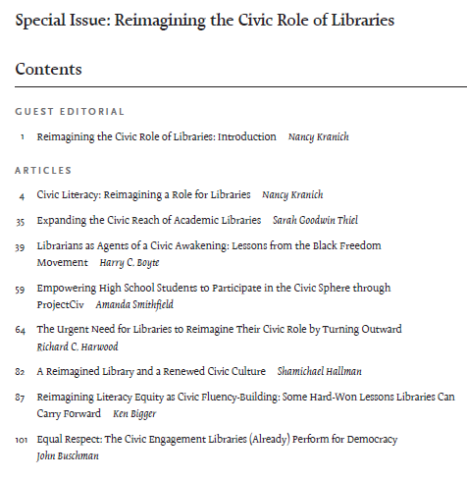
WHY?

Slide 9
WHY?
Beyond “it’s the right thing to do”…

Slide 10
WHY?
Beyond “it’s the right thing to do”…
Massachusetts Library staff brainstormed:

Slide 11
At the Librarians Fostering Civic Engagement workshops… attendees participated in a brainstorming activity. The lists… outline responses from attendees at the 7 workshops offered throughout Massachusetts.

Slide 12
Connect people with community knowledge.
Democracy and diversity.
Demonstrate value and promote services.
Foundational to our mission and role.
Give voice to needs.
Help the library understand needs and gaps.
Increase social engagement and generate connectedness.
Increase community engagement.
Increase literacy and responds to lack of civic literacy. Disseminates information.
It's fun and rewarding.
Librarians are trusted, non-partisan, good stewards.
Libraries are the logical place with readily available, free resources for all.
Libraries bring people together. Foster collaboration and create a strong, healthy community.
Libraries Transform.
Reach all ages.

Slide 13
Connect people with community knowledge.
Democracy and diversity.
Demonstrate value and promote services.
Foundational to our mission and role.
Give voice to needs.
Help the library understand needs and gaps.
Increase social engagement and generate connectedness.
Increase community engagement.
Increase community engagement.
Increase literacy and responds to lack of civic literacy. Disseminates information.
It's fun and rewarding.
Librarians are trusted, non-partisan, good stewards.
Libraries are the logical place with readily available, free resources for all.
Libraries bring people together. Foster collaboration and create a strong, healthy community.
Libraries Transform.
Reach all ages.

Slide 14
Connect people with community knowledge.
Democracy and diversity.
Demonstrate value and promote services.
Foundational to our mission and role.
Give voice to needs.
Help the library understand needs and gaps.
Increase social engagement and generate connectedness.
Increase literacy and responds to lack of civic literacy. Disseminates information.
It's fun and rewarding.
Librarians are trusted, non-partisan, good stewards.
Libraries are the logical place with readily available, free resources for all.
Libraries bring people together. Foster collaboration and create a strong, healthy community.
Libraries Transform.
Reach all ages.

Slide 15
WHY ELSE?
You have the space, and people know the space,
and know you.
And…

Slide 16
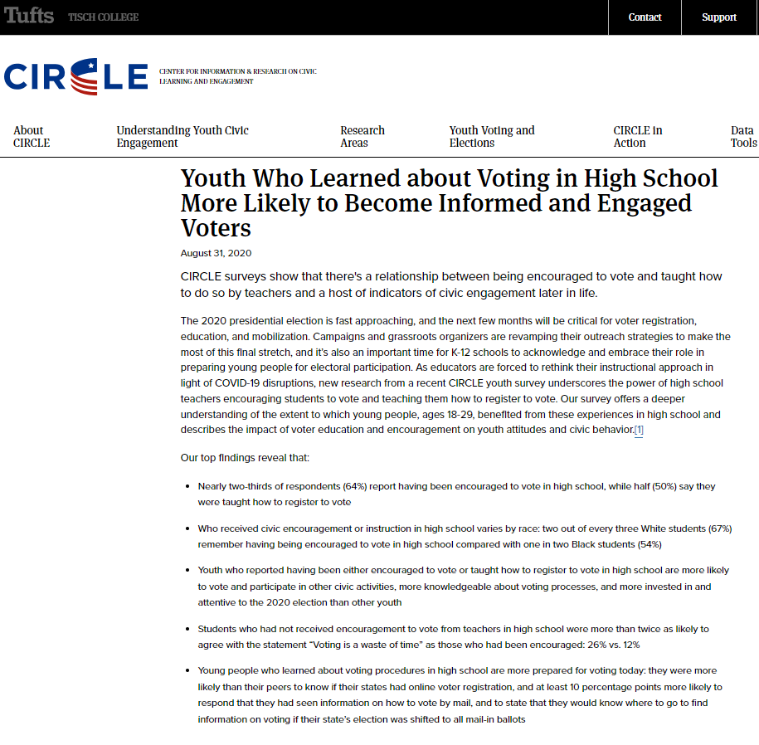
WHY ELSE?

Slide 17
WITH WHOM?

Slide 18
WITH WHOM?
You don’t have to do this alone.

Slide 19
WITH WHOM?
You don’t have to do this alone.
You don’t have to reinvent the wheel.

Slide 20
WITH WHOM?
You don’t have to do this alone.
You don’t have to reinvent the wheel.
Office of Minnesota Secretary of State
County Elections Office
City Elections/Clerk/Auditor
Campus Vote Coordinator (postsecondary)
Like-Minded Compatriots
Community: groups and individuals (ASK!)

Slide 21
WITH WHOM?

Slide 22
FOR WHOM?

Slide 23
FOR WHOM?
Everybody

Slide 24
WHERE?

Slide 25
FOR WHOM?
Everybody
Voting Eligible/ Future Voters
Age
Citizenship
Interest
Community Members
Visitors (in person or online)

Slide 26
WHERE/HOW?
In Person
At Your Library
Displays
Materials
Events
Mock
Walk-throughs
Other Locations (Partnerships?)
Virtual

Slide 27
WHERE/HOW?
Virtual
Simultaneous w/in-person? (challenges)
vs. Dedicated Virtual
Live vs. Recorded (virtual or in-person)
Posted
Videos
Articles
Printables
Links

Slide 28
Resources:
www.MNVotes.Gov
www.ala.org/advocacy/voter-engagement
https://guides.masslibsystem.org/CivicEngagement/
https://www.imls.gov/blog/2022/03/how-museums-and-libraries-are-fostering-civic-engagement-through-voting
https://programminglibrarian.org/articles/public-participation-how-libraries-support-civically-engaged-communities
Kranich, N. (2012) Libraries and civic engagement. Library and book trade almanac, 2012, 75-96.
Young, R. (2012) More than just books: The role of public libraries in building community and promoting civic engagement. National civic review, 101(4), 30-33.

Slide 29
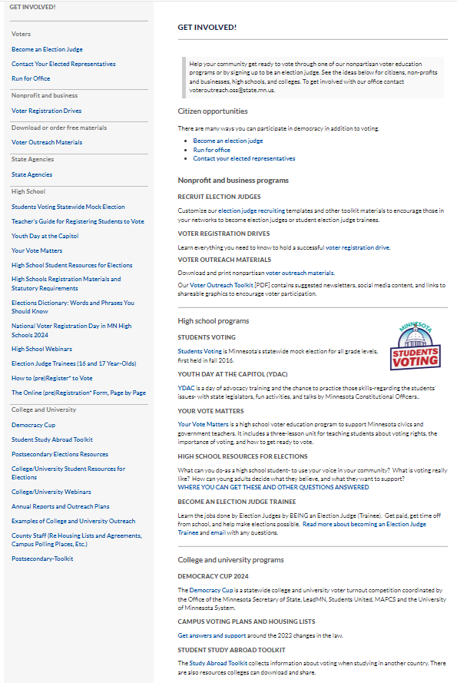

Slide 30
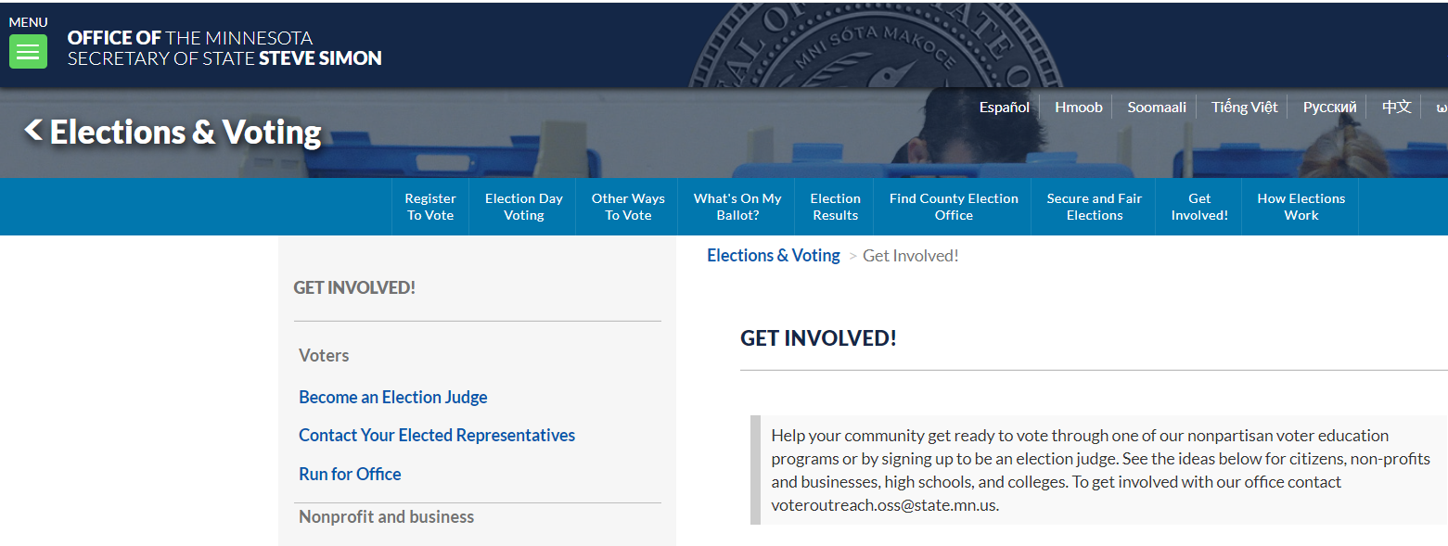

Slide 31
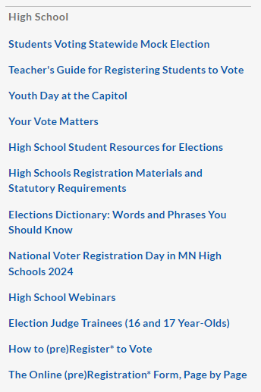
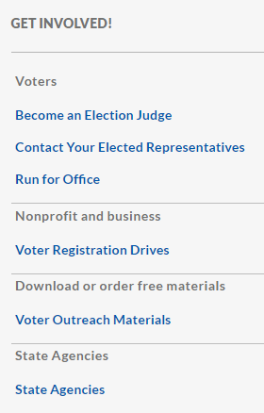
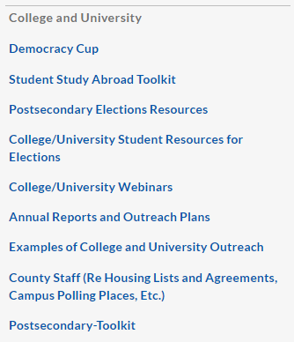

Slide 32
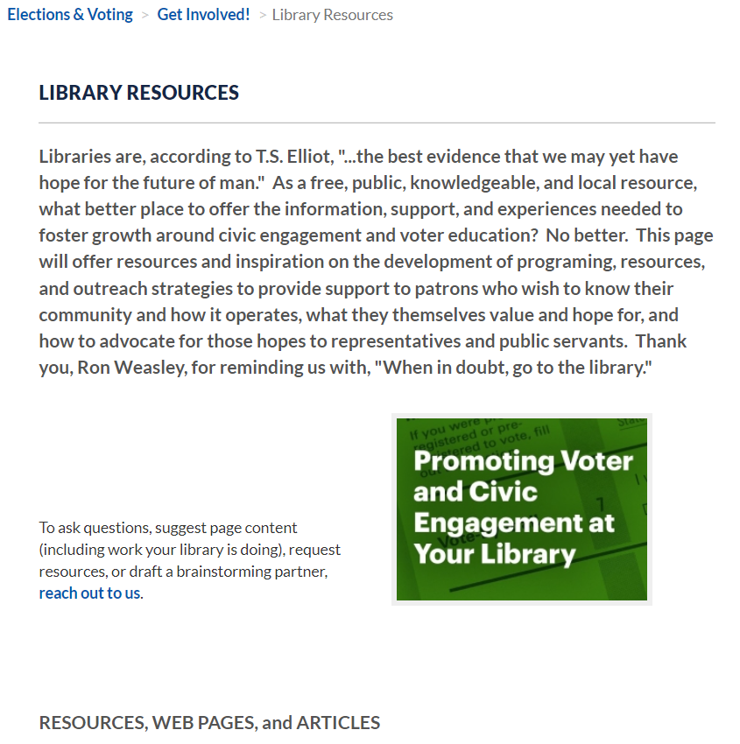
Resources:

Slide 33
Resources:
www.MNVotes.Gov
www.ala.org/advocacy/voter-engagement
https://guides.masslibsystem.org/CivicEngagement/
https://www.imls.gov/blog/2022/03/how-museums-and-libraries-are-fostering-civic-engagement-through-voting
https://programminglibrarian.org/articles/public-participation-how-libraries-support-civically-engaged-communities
Kranich, N. (2012) Libraries and civic engagement. Library and book trade almanac, 2012, 75-96.
Young, R. (2012) More than just books: The role of public libraries in building community and promoting civic engagement. National civic review, 101(4), 30-33.

Slide 34
Questions.

Slide 35
CONTACT INFORMATION
Michael Wall
Youth Voter Outreach Specialist
Michael.Wall@state.mn.us
651-201-6892

