Slide 1
Elections and Voter Outreach for Postsecondary Institutions
-------------
Lunch and Learn: May 17, 2024

Slide 2
College and University Voter Outreach Work

Slide 3
College and University Voter Outreach Work
Pre-2016
Individual efforts
2012 NTFCLDE
2013 NSLVE nslve@tufts.edu ​
Associations

Slide 4
College and University Voter Outreach Work
Pre-2016
2016-2020

Slide 5
College and University Voter Outreach Work
Pre-2016
2016-2020
2020

Slide 6
New Laws Passed in Spring of 2023

Slide 7
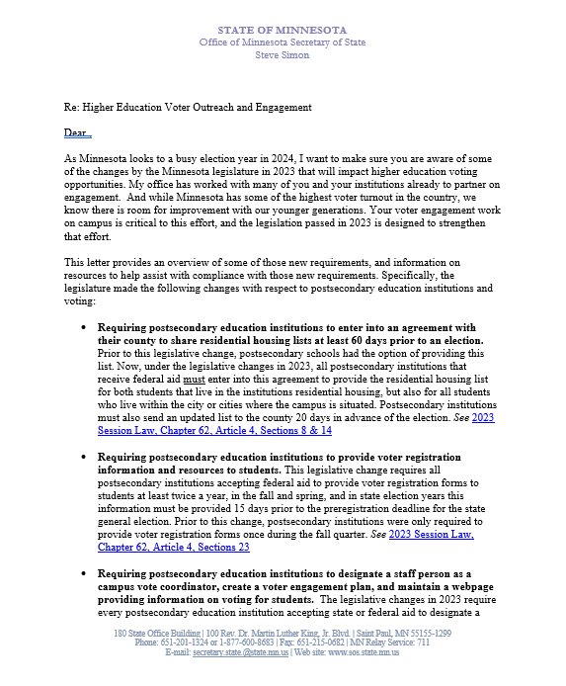
Letter From Secretary Simon Sent Fall 2023

Slide 8
1 2 3 4 5 6 7
Elections Items That Minnesota Law Says Colleges and Universities Must Do

Slide 9
1 2 3 4 5 6 7
Please and Thank You.

Slide 10
Share at every step,
And we will share
With everyone.

Slide 11
1 2 3 4 5 6 7 8
Written agreement to County Auditor
To provide student housing lists for each election
By 60 days before the first election of the year.
Lasts for the calendar year

Slide 12
1 2 3 4 5 6 7 8
Prepare current list of enrolled students
Living in campus housing
Living in the campus city/cities (state aid)
-MAY include up to 10 miles from campus (federal aid)
Certified (signed off as current and accurate)
To Auditor each election (not before 20 days prior)

Slide 13
1 2 3 4 5 6 7 8
Provide registration forms to each student
Spring of each year
Fall of each year
Even years: delivered at least 36 days before the state general (November) election.
If form is provided electronically, email or text must be exclusively about voter registration.

Slide 14
1 2 3 4 5 6 7 8
Consult with campus student government
Most effective means of:
Distributing forms
Facilitating election day registration of students
To create voter engagement plan/report (#7)

Slide 15
1 2 3 4 5 6 7 8
Web page of voter/elections information
Voter registration and voting requirements
Deadlines
Residency requirements/methods to prove
Voting options
Resources for students registered in other states
Campus vote coordinator name/contact (see #6)
Voter engagement plan/report (see #7)

Slide 16
1 2 3 4 5 6 7 8
Designate staff Campus Vote Coordinator
Ensure institution complies requirements
Consult with campus student government (see #4)

Slide 17
1 2 3 4 5 6 7 8
Submit annual campus voter engagement report/plan by November 30
Outline efforts to implement these items
How and when registration forms were distributed
Campus voter engagement plan

Slide 18
1 2 3 4 5 6 7 (8)
The County Auditor shall notify all postsecondary educational institutions about these requirements.

Slide 19
1 2 3 4 5 6 7 (8)
The County Auditor shall notify all postsecondary educational institutions about these requirements.
REACH OUT TO YOUR COUNTY ELECTIONS OFFICE

Slide 20
1 2 3 4 5 6 7 (8)
The County Auditor shall notify all postsecondary educational institutions about these requirements.
REACH OUT TO YOUR COUNTY ELECTIONS OFFICE
Get the best contact for questions
Ask for their preferred:
Fields for the housing list
List format (sorting, etc.)
Tips/advice

Slide 21
Find all of these and the statutes behind them here:
https://www.sos.state.mn.us/elections-voting/get-involved/postsecondary-elections-resources/
Michael Wall, Youth Voter Outreach Specialist
Michael.Wall@state.mn.us 651-201-6892

Slide 22
College and University Resources
Conference (Voter Summit, 6/11/24)
https://secure.everyaction.com/0dR69lh-ZUWer_IWj_t7hg2
Webinars (like this one)
https://www.sos.state.mn.us/elections-voting/get-involved/collegeuniversity-webinars/
OSS Consultation, networking
Groups, clubs, organizations, SGA, offices…
Each other (associations, 1-on-1, OSS)
Web Pages

Slide 23
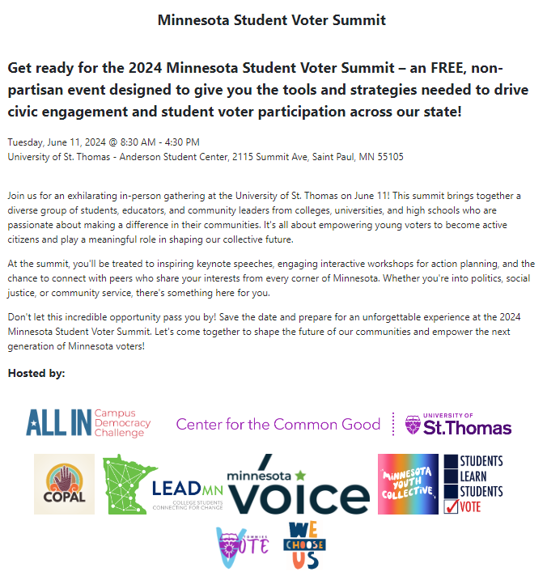

Slide 25
College and University Resources
Conference (Voter Summit, 6/11/24)
https://secure.everyaction.com/0dR69lh-ZUWer_IWj_t7hg2
Webinars (like this one)
https://www.sos.state.mn.us/elections-voting/get-involved/collegeuniversity-webinars/
OSS Consultation, networking
Groups, clubs, organizations, SGA, offices…
Each other (associations, 1-on-1, OSS)
Web Pages

Slide 26
College and University Resources
Conference (Voter Summit, 6/11/24)
https://secure.everyaction.com/0dR69lh-ZUWer_IWj_t7hg2
Webinars (like this one)
https://www.sos.state.mn.us/elections-voting/get-involved/collegeuniversity-webinars/
OSS Consultation, networking
Groups, clubs, organizations, SGA, offices…
Each other (associations, 1-on-1, OSS)
Web Pages
Community Groups…

Slide 27
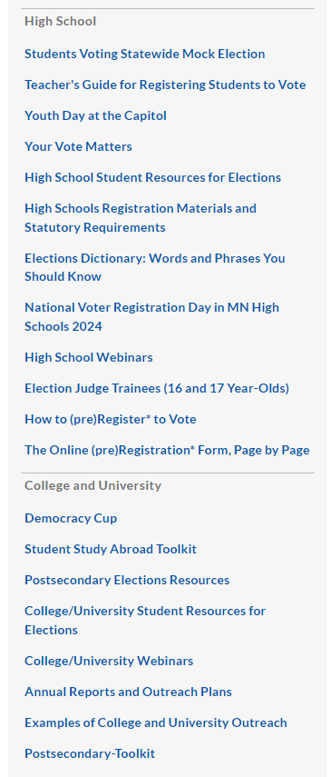
www.sos.state.mn.us/elections-voting/get-involved/

Slide 28
www.sos.state.mn.us/elections-voting/get-involved/

Slide 29
www.sos.state.mn.us/elections-voting/get-involved/

Slide 30
QUESTIONS

Slide 31
CONTACT INFORMATION
Michael Wall
Youth Voter Outreach Specialist
Michael.Wall@state.mn.us
651-201-6892

